Slide 1
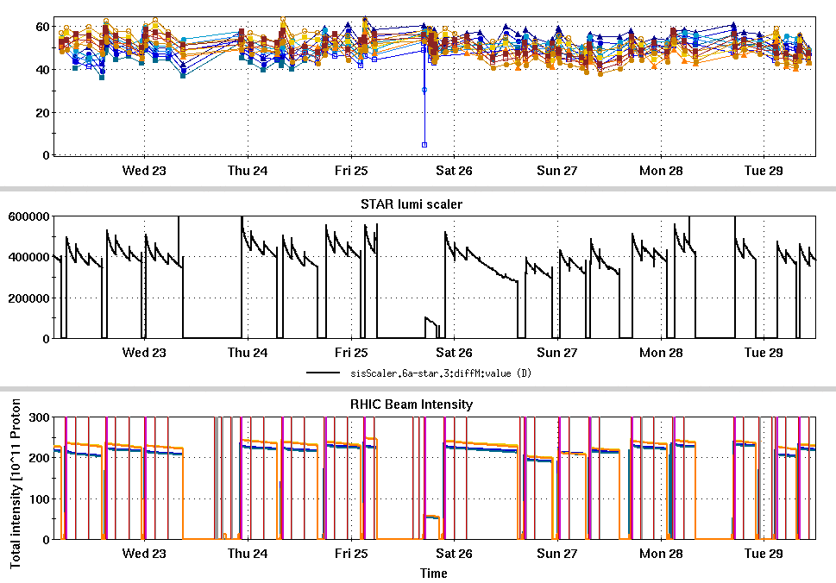
RHIC Run 22 Run Status 3/29/2022, V. Schoefer
RHIC pC [%]
Difficult weekend
Long downtime on Friday
Booster RF failure affected lumi and polarization for several stores
Performance generally lower relative to previous optimum e.g. (fills 33205-33220)
Stable spin direction measurement at the pC polarimeter done on Friday
STAR ZDC [Hz]
pC spin direction MD
Abort relay, sextupole access
Maintenance
IR4 DX and D0 failure
CeC
Booster RF
RHIC Intensity [1e11]

Slide 2
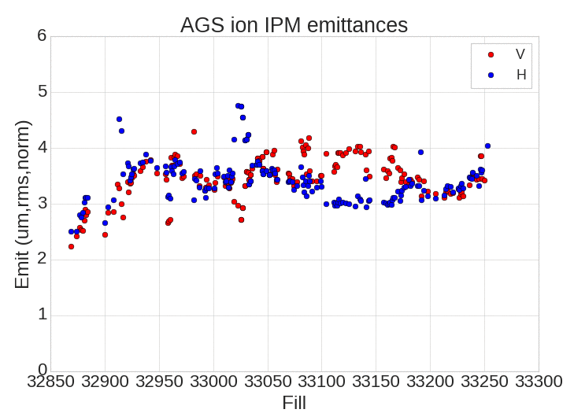
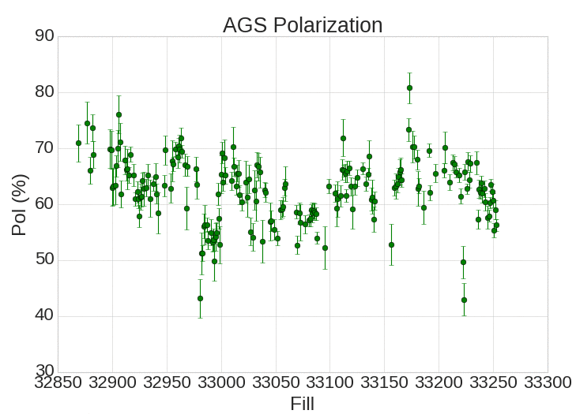
AGS Emittance and Polarization
Some weekend fills affected by Bootser E6 failure (larger emittance)
Emittances still larger than previous optimal performance.

Slide 3
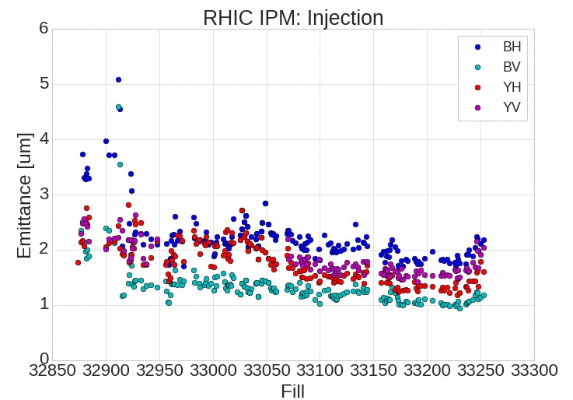
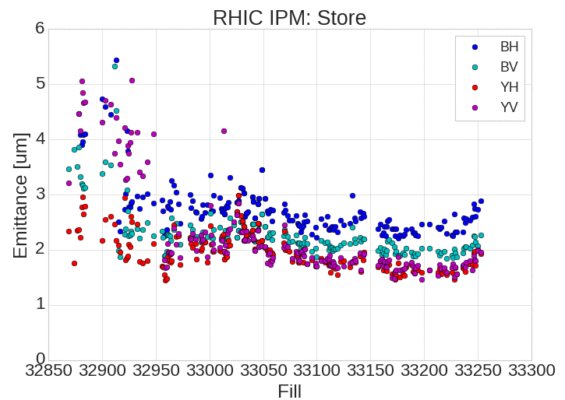
RHIC Emittance
AGS larger emittances clearly propagating through to store

Slide 4
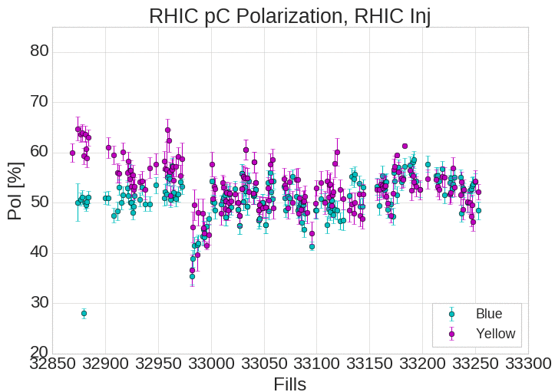
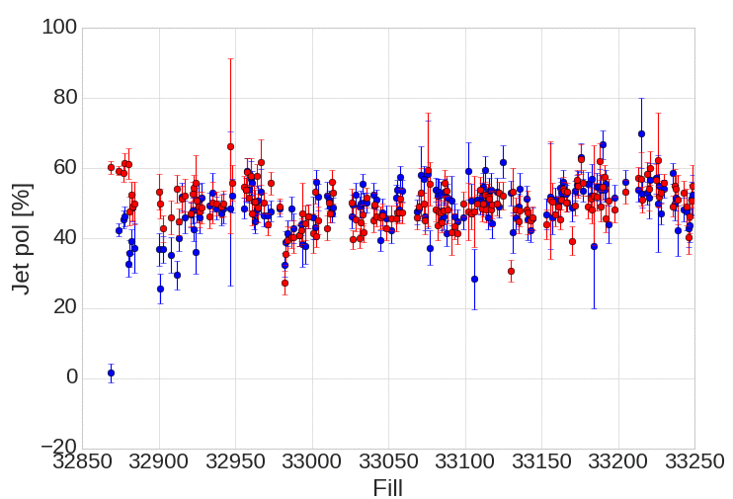
RHIC Polarization
Most recent 2 fills are in the lower 50s. Weekend average in the 40’s.
Jet pol

Slide 5
Plans
As much physics as possible
20 days remain in run
CeC has ~12 dedicated days remaining
Development, including spin direction measurements are finished except for any last minute refinements or verifications

