Slide 1
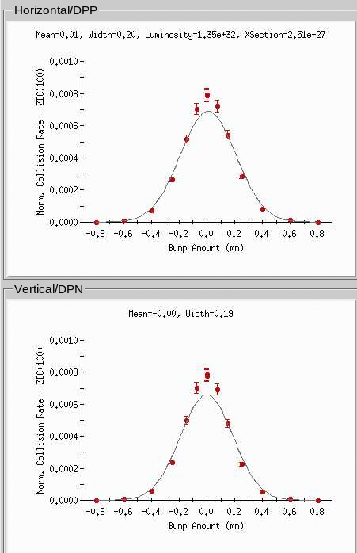
Vernier scans RHIC run22
Online (“lisa”):
No singles correction
Only 1G fit
Using model “bump”
Offline:
Singles correction
2G or 2G+const fit
Model or BPM
Moving ring only
Both rings
Total of 14 scans
High and low intensity
28-111 bunches
Gain x1 and x10
Blue and Yellow
3 different ramps

Slide 2
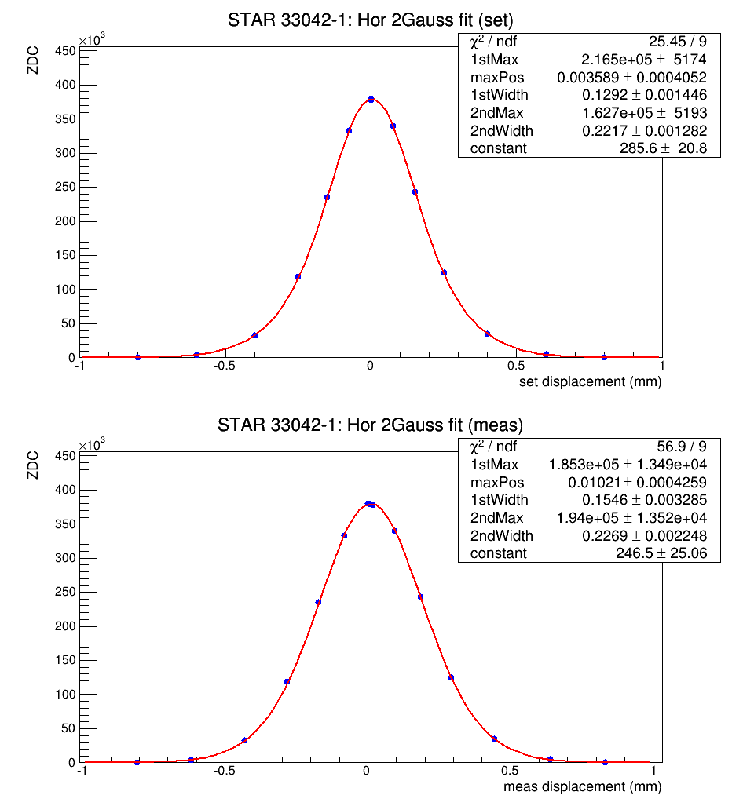
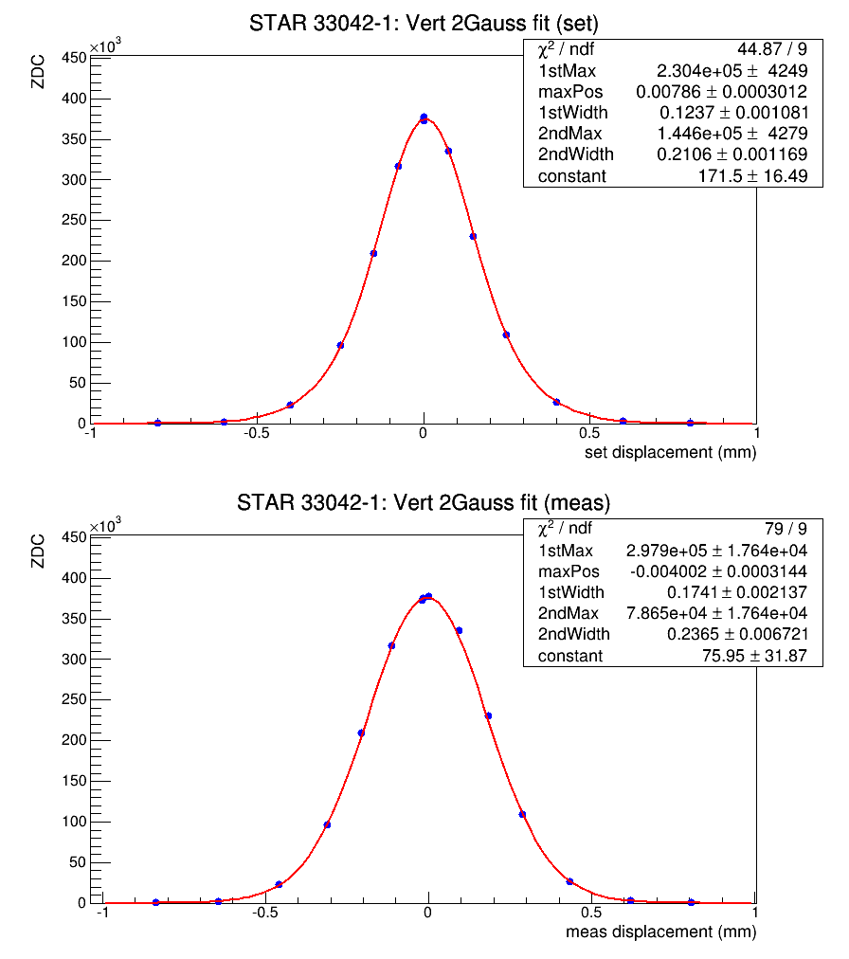
33042 #1, 111x111 beta* 1.2 m, Y
Model (set) fits typically have better chi^2

Slide 3
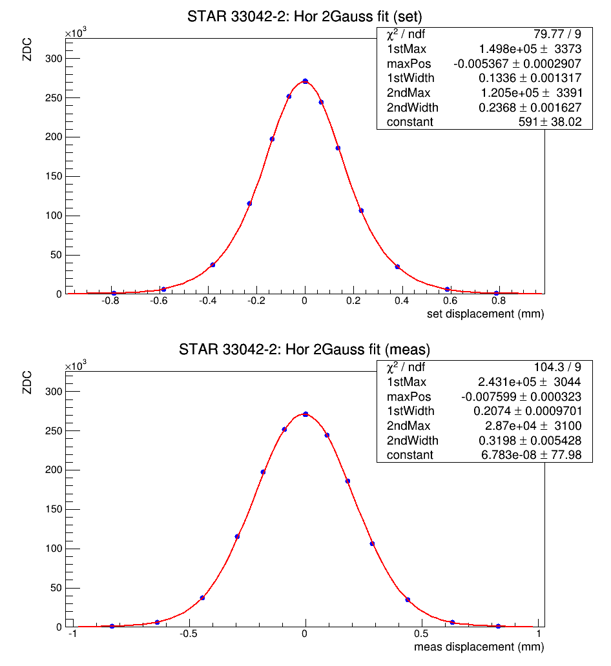
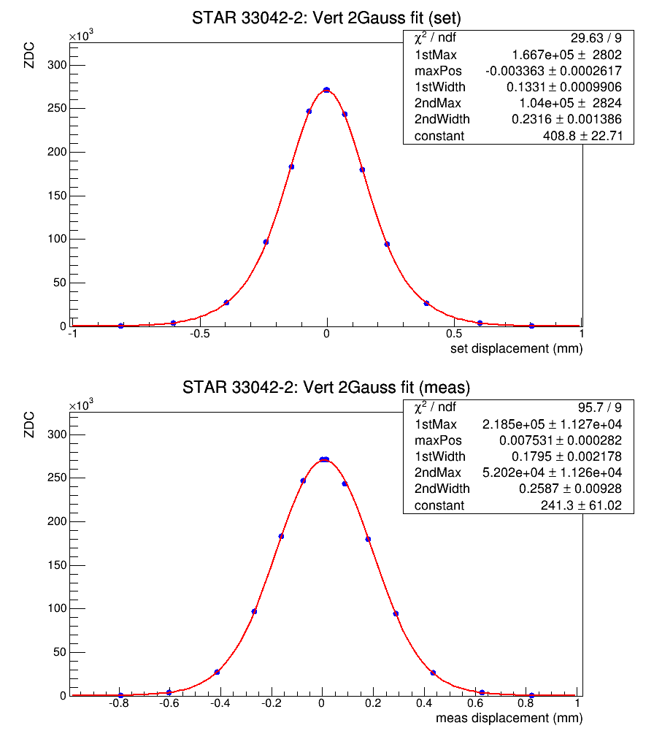
33042 #2, 111x111, beta* 1.0 m, Y
Discrepancy between model and set is evident regardless of rampfile

Slide 4
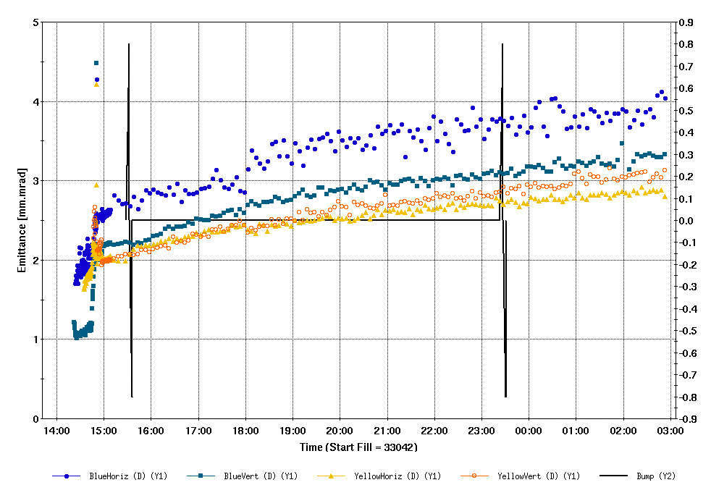
Comparison vscan with IPM emittance
IPM scatter is rather large
Blue is typically larger than yellow
Expect vscan results between blue and yellow

Slide 5
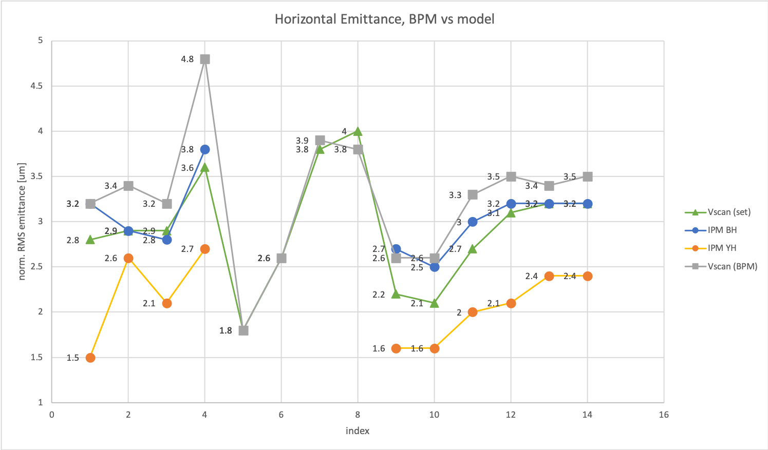
IPM and vscan (Hor)
Low intensity

Slide 6
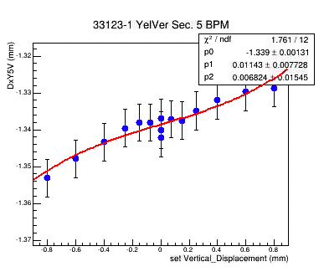
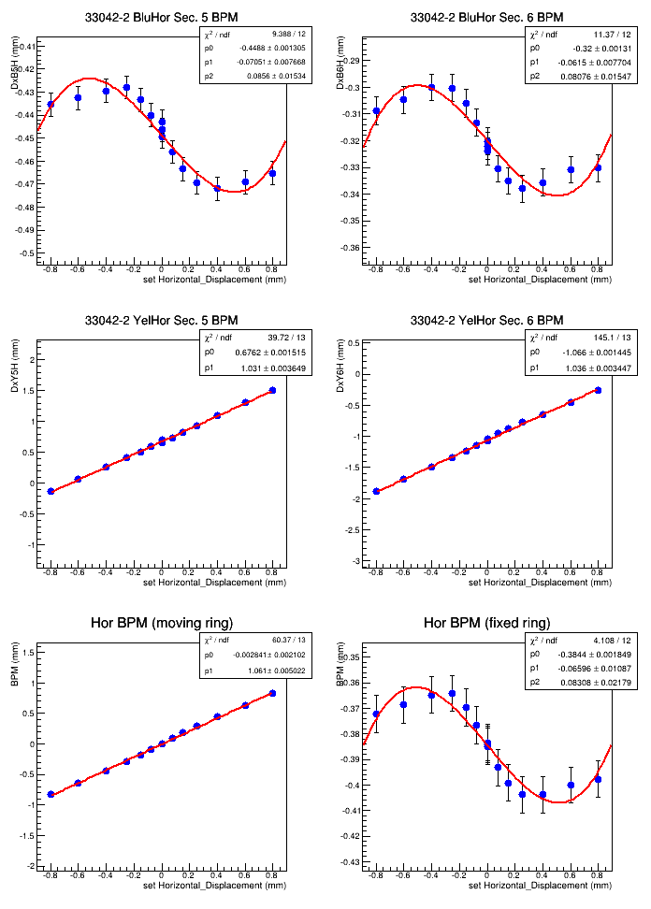
Beam-beam or electronic cross talk?
20 um
fixed
moving
Low intensity: likely electronic cross talk
High intensity: Beam-beam
Combine east&west

Slide 7
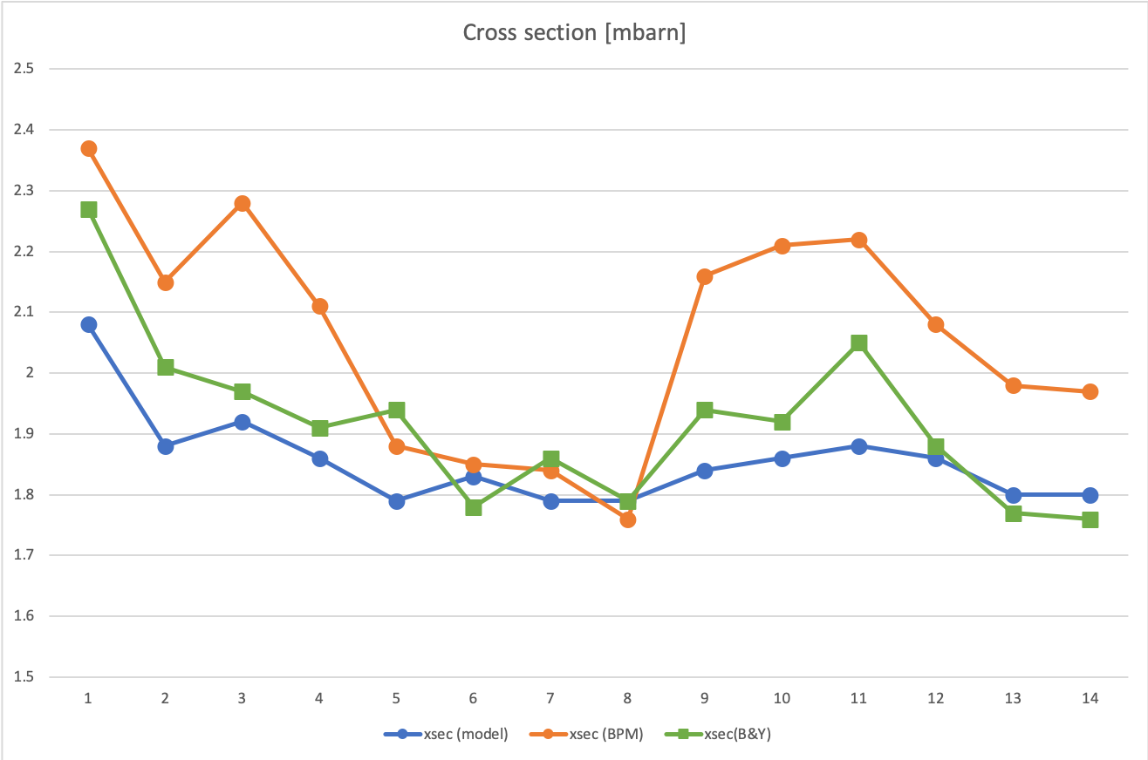
ZDC effective cross section pp22-255GeV
Gain
x1
1.86
33172-sq1
Low intensity
Cross section should be constant regardless of beam conditions

Slide 8
summary
Cross section should be constant:
Only using “set” values satisfies this ‘rule’
Compare with independent measurement (IPM):
“set” values give best agreement with IPM
Rampfile does not appear to matter
Low intensity stores:
No apparent beam-beam
“set” and BPM agree within 5%
Using both rings more ‘random’
BPM vs “set” consistent with beam-beam
Intensity dependent
Electronic cross talk and beam-beam evident
Using both rings AND correct gain gives best agreement also for high intensity stores (need to work on understanding gain calibration)
Conclude:
Keep using “set” values
Avg. of 1.86 mbarn

