Slide 1
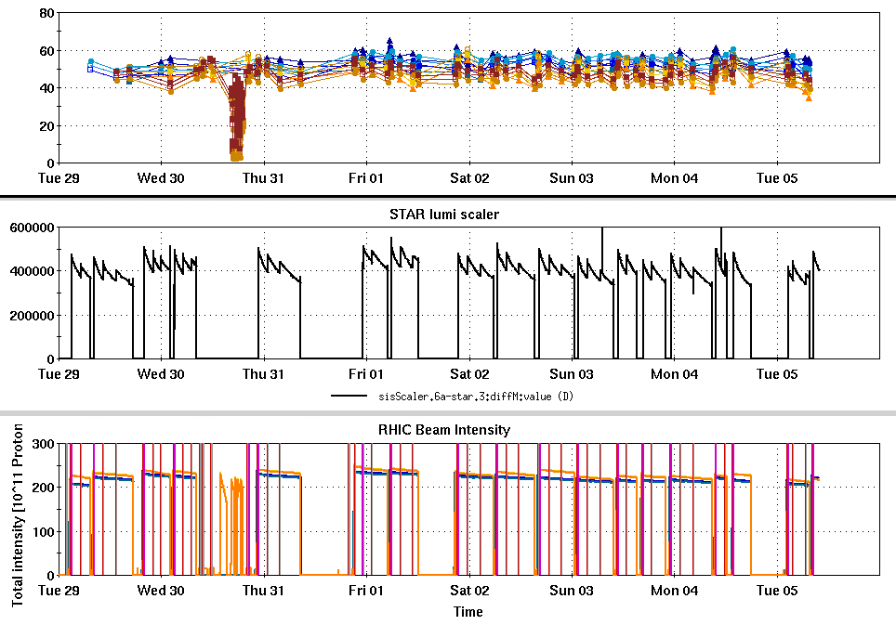
RHIC Run 22 Run Status 4/05/2022, V. Schoefer
RHIC pC [%]
Good running conditions and high uptime for most of week
Significant interruptions to physics were all planned (APEX, CEC)
Reduced AGS intensity for fills from 2.4 to 2.2x10¹¹ to reflect updated cross section and lumi target
STAR ZDC [Hz]
APEX
CeC
CeC
CeC
RHIC Intensity [1e11]

Slide 2
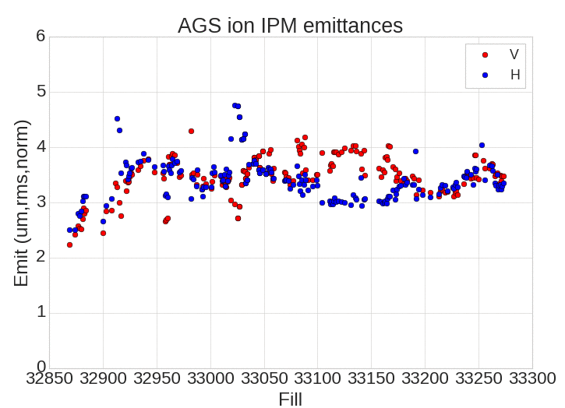
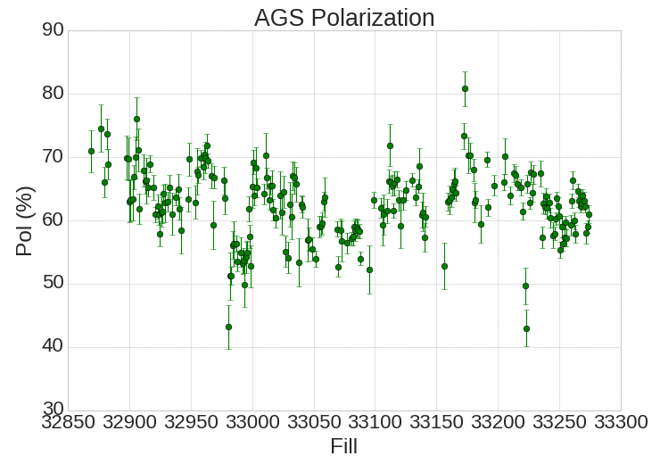
AGS Emittance and Polarization
Linac-to-AGS flattop work last week improved both emittance and polarization (though not to previous best, even at lower intensity
Last three fills polarization trending back down

Slide 3
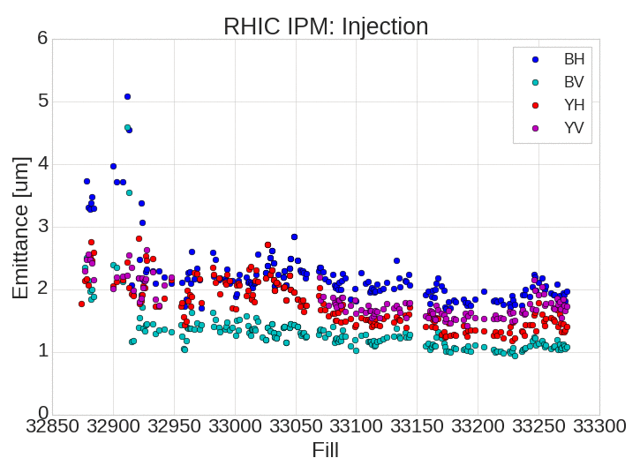
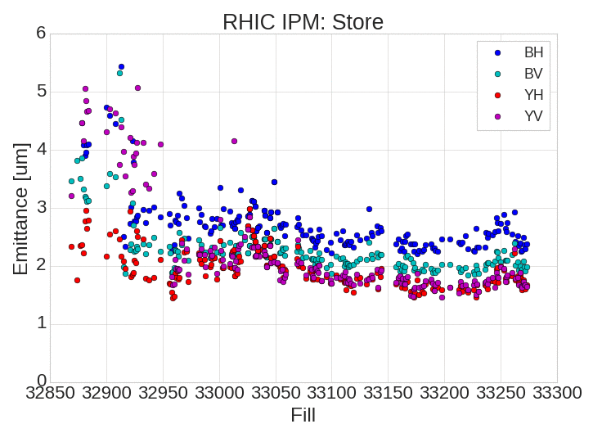
RHIC Emittance
Trending down, but not yet at previous best. Correlated with AGS

Slide 4
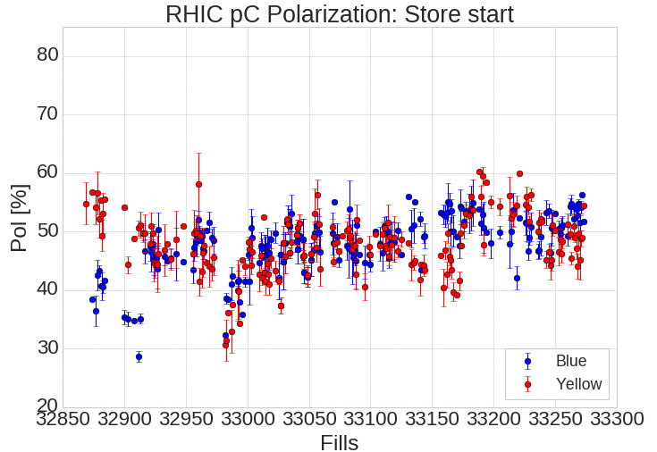
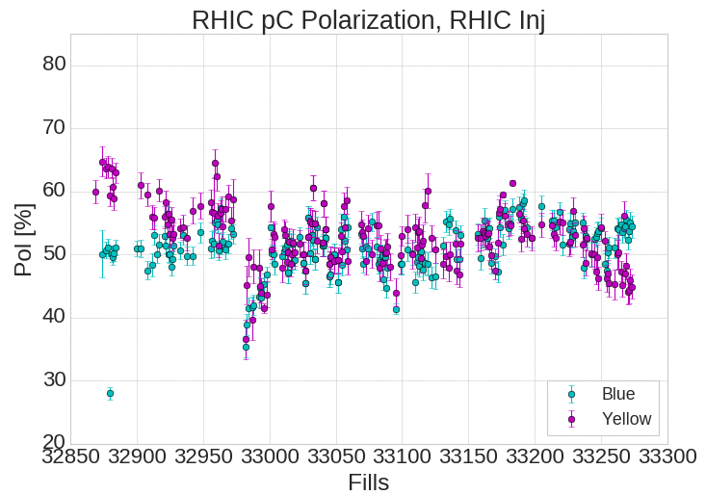
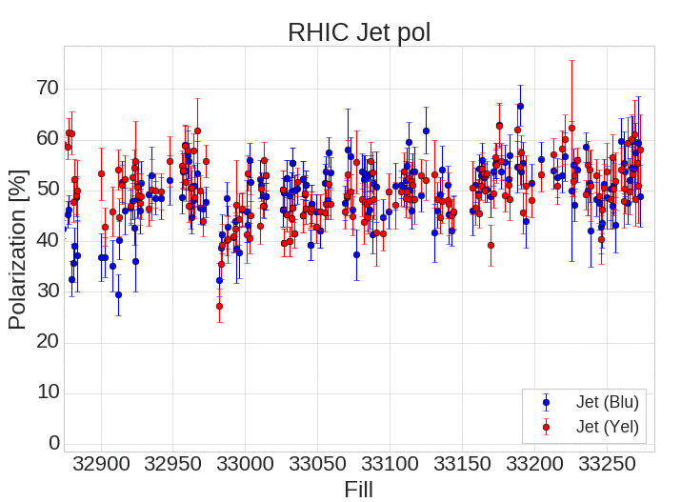
RHIC Polarization
Jet average from weekend ~53% in both rings
Apparent Blue-yellow difference in pC, not obvious in the Jet data
Jet pol

Slide 5
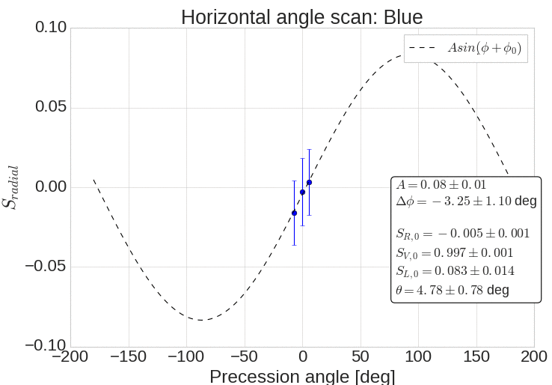
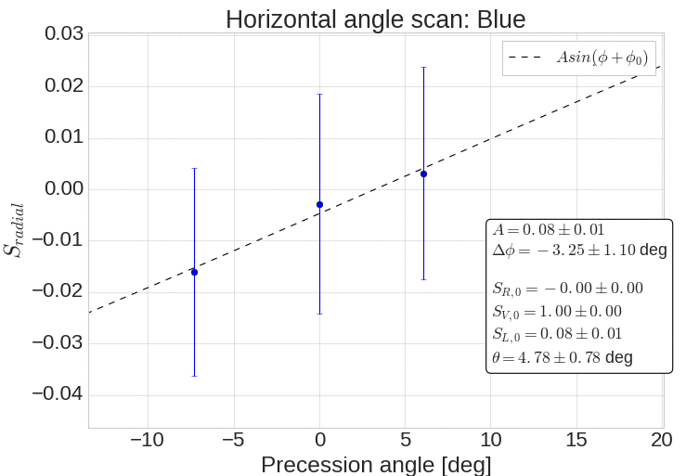
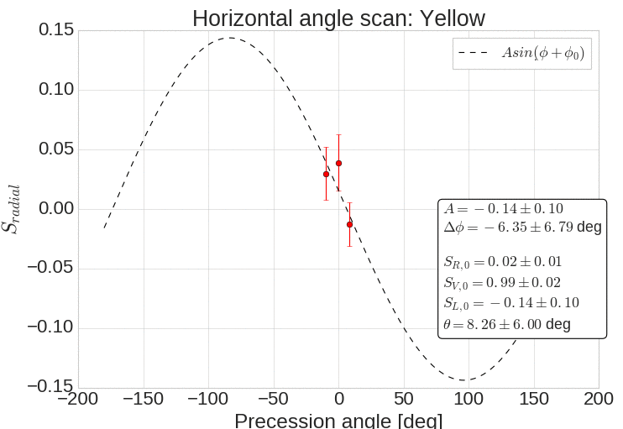
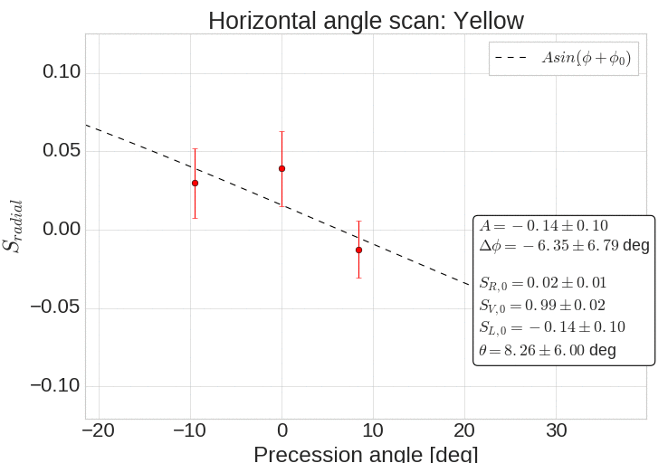
Measurement of stable spin direction at p-Carbon polarimeters using horizontal orbit angles
Goal of measurement is to infer the longitudinal component, S_{long}, by precessing the stable spin direction about the vertical and measuring S_{radial}. The vertical component S_{vert} remains constant.
Experimental power limited by aperture and corrector strength (limited to +/- 10 deg of spin precession)
Blue: fit is ok, total tilt from vertical ~5 deg, almost entirely longitudinal
Yellow: Not a good fit, larger resulting uncertainty. We should repeat and combine measurements

Slide 6
Plans
As much physics as possible
13 days remain in run
Minimize impact of mode switches in and out of Au for CeC
Two hour end-of-store measurement planned to improve statistics on the pC spin direction measurement (Wednesday)

