Slide 1
APEX Report
Time meeting, April 12, 2022

Slide 2
Results: Transparency Mode Study ( March 30 ) led by Haixin

Slide 3
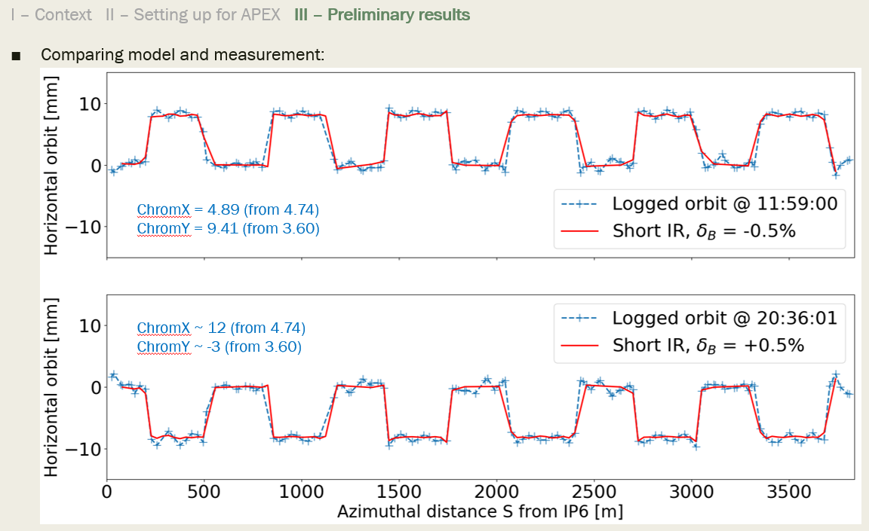
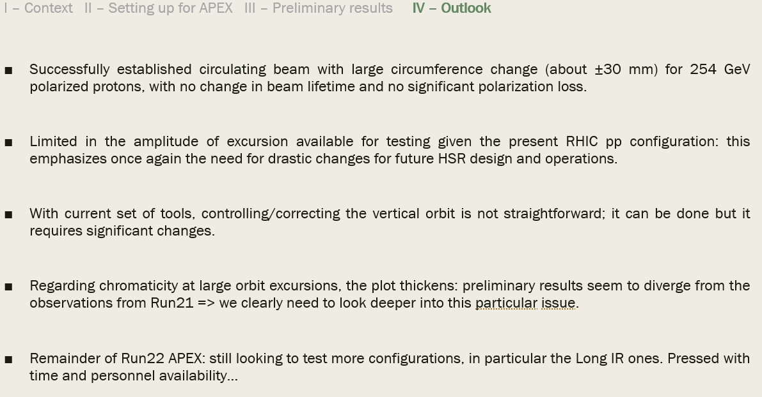
Results: Radial shift orbit, led by Guillaume

Slide 4
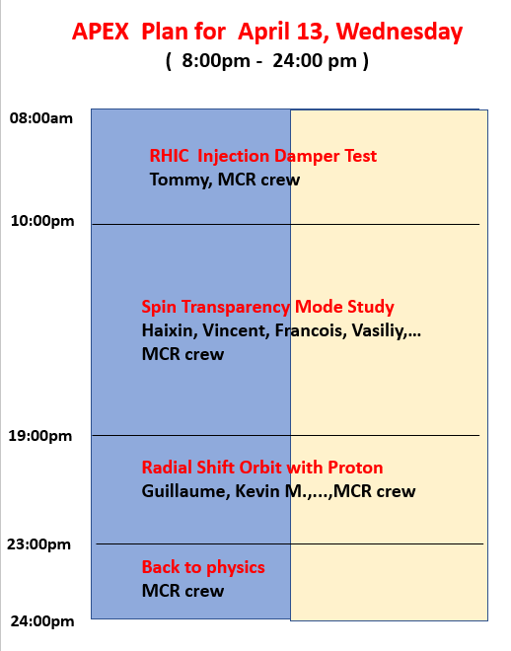
One uncertainty: if ramp file not ready, radial shift orbit test may not happen.

