Slide 1
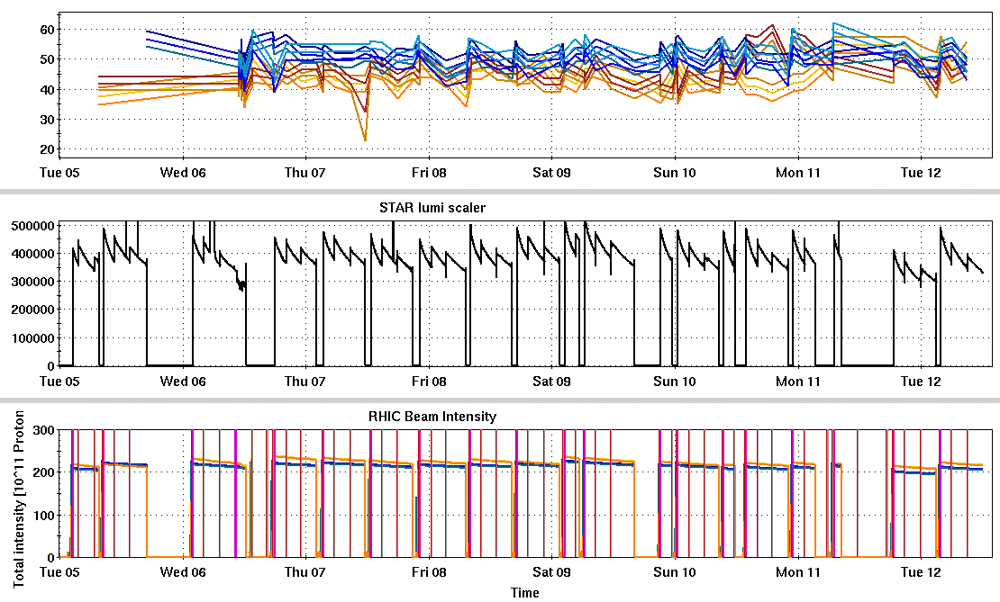
RHIC Run 22 Run Status 4/12/2022, V. Schoefer
Generally good uptime. Major interruptions:
Power dip 3/6
IR10 D0 supply
QLI aborted two stores
DX heaters fired (at IP4?)
Snakes near DX heater also quench
AGS intensity now between 2.1-2.2e11 to meet average lumi goals (with 1.86 mb cross section)
5% lower than previous week
RHIC pC [%]
Power dip
STAR ZDC [Hz]
CeC
CeC
D0 p.s. fail
RHIC Intensity [1e11]

Slide 2
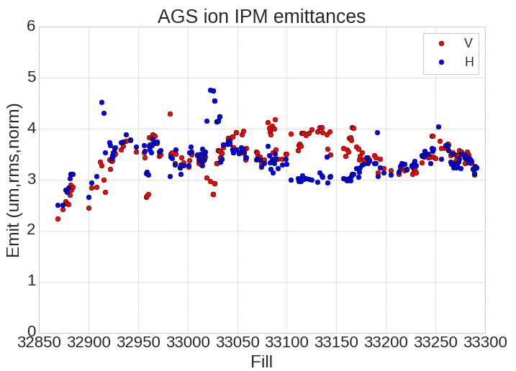
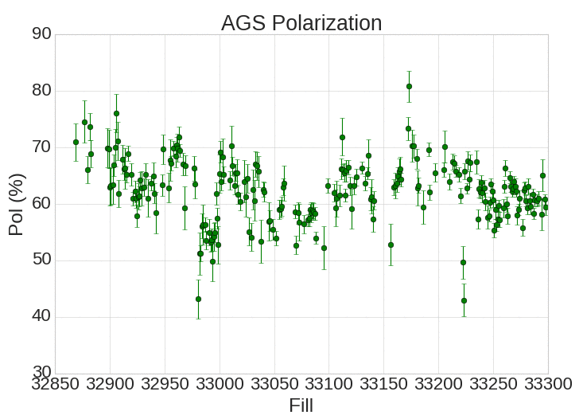
AGS Emittance and Polarization
AGS emittances as good as previous optimum
AGS masured polarization till in low 60’s: some suspicion that this is instrumental, given high downstream RHIC numbers

Slide 3
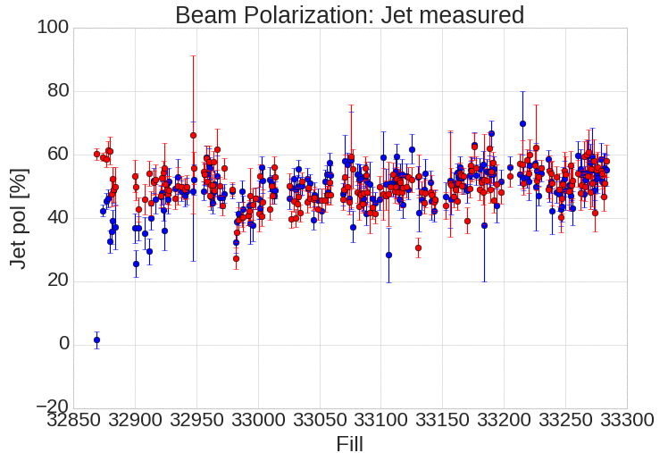
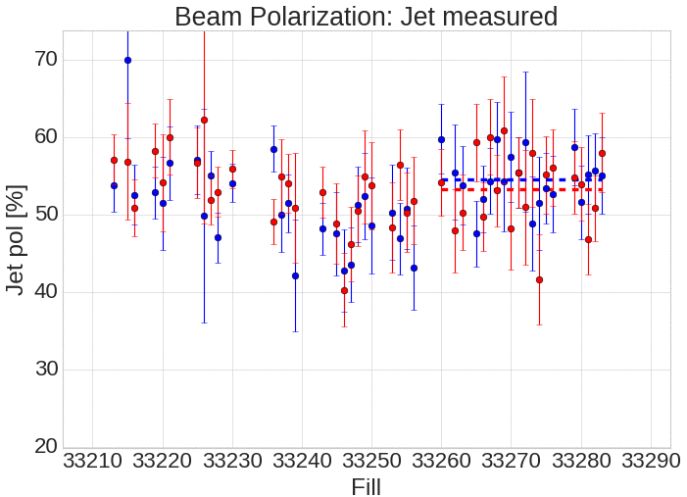
RHIC Polarization
Full run
Recent fills
Averages since injector work last week (fill >33260):
Blue 54.5%
Yellow 53.5%

Slide 4
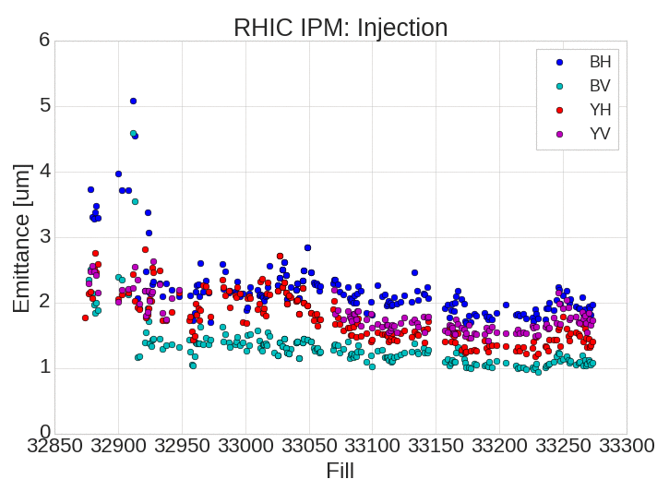
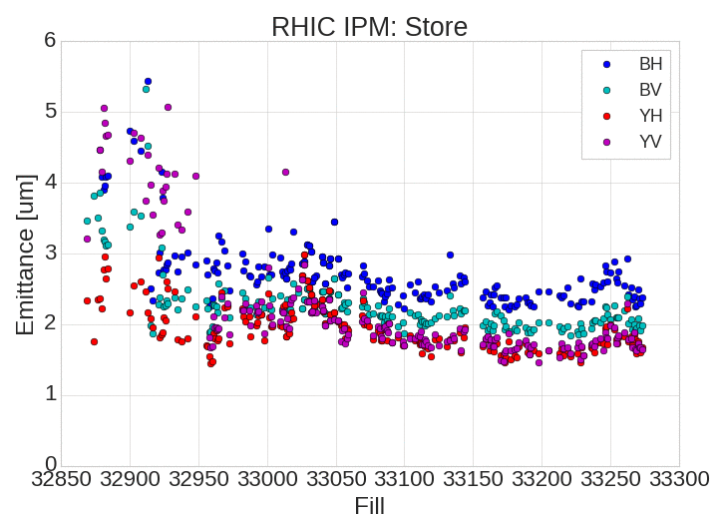
RHIC Emittance
Close to previous optimum
Helped by taking less intensity from AGS

Slide 5
Plans
As much physics as possible
6 days remain in run
16 hours for APEX
Accommodate remaining CeC requests for time
Two hour end-of-store measurement provisionally planned to repeat pC spin direction measurement.

Slide 6
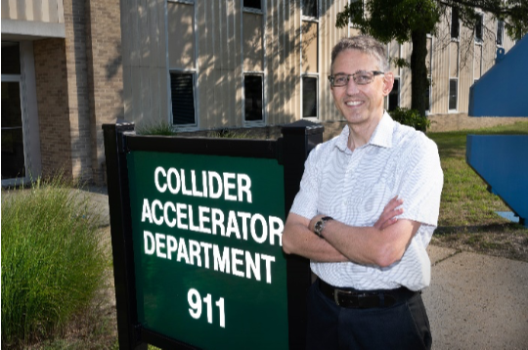
Wolfram’s Tale of Woe
Particle Post, Mar 2022
90% as of Monday morning
…..and that’s just a partial list….
Thanks to everyone at CAD (and Magnet Division!) for making this impossible exhausting ridiculous maddening remarkable run as successful as it was!

Slide 7
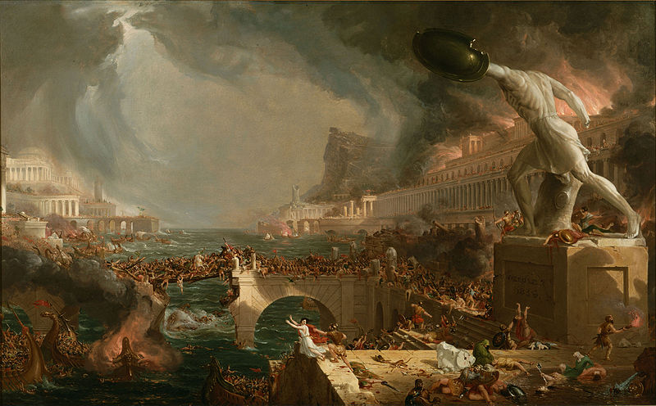
Run Planning
Run Doing
Thanks!

