Slide 1
RHIC/Experiments Coordination Meeting: Run 22, 11/16/2021
Setup Status
Review of (an) improvement relative to Run 17
Why?
Startup plan modifications with the delay

Slide 2
Status
RHIC cooldown started Mon 11/15
Full cooldown delays first beam to ~12/5 (for cryo work)
AGS setup paused for BtA obstruction remediation
Replacement of valve piece with bellows with nitrogen scrubbing and partial bake to hopefully avoid a full bakeout (Fri 11/19 eve—Mon 11/22 morning).
Resumption of AGS setup Monday if pressure checks out.
Leaves 2 calendar weeks for AGS setup.

Slide 3
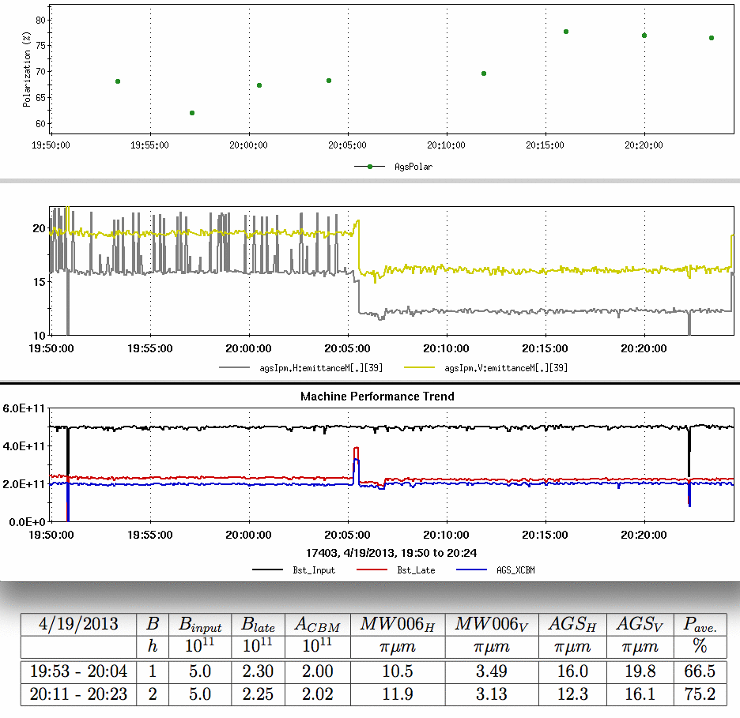
Two bunches in AGS from Run 13
Polarization
H=2
H=1
In Run 13, proton bunches were captured on h=2 at Booster injection and accelerated to AGS extraction as two bunches as a test
Improvement at the time
20% emittance improvement
12% (relative) polarization improvement
Center-measured in AGS
The proposed scheme splits in the Booster instead of h=2 capture to preserve dual harmonic capture (which gives lower peak currents at Booster injection)
Emittance (95%,norm)
Intensity
3
Data from H. Huang

Slide 4
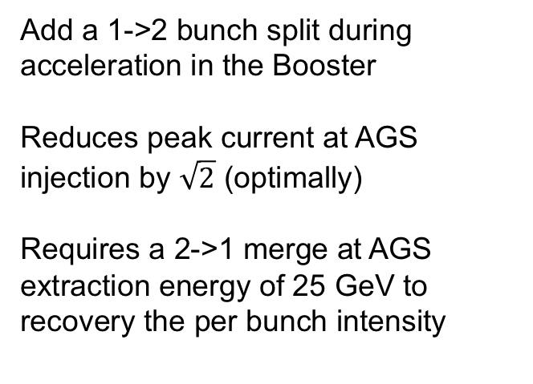
Bunch split and merge scheme
Present scheme:
A single pulse from the source remains a single bunch from source to collision
Booster and AGS injection both have defocusing RF harmonics
Present scheme: Single bunch from source to RHIC, dual harmonic RF at Booster and AGS injection
Extract to RHIC
Booster
Extract to AGS
AGS
Dual harmonic RF (h=1,2,adiabatic capture)
Dual harmonic RF (h=6,12)
Add a 1->2 bunch split during acceleration in the Booster
Reduces peak current at AGS injection by $\sqrt{2}$ (optimally)
Requires a 2->1 merge at AGS extraction energy of 25 GeV to recovery the per bunch intensity
Proposed scheme: Add a longitudinal split in Booster and merge in AGS at 25.5 GeV
Booster
AGS
Extract to RHIC
Extract to AGS
Bunch Merge
h=12->6
Dual harmonic RF
Bunch Split
Dual harmonic RF

Slide 5
Run 21 Split/merge test
January 2021 pre-run test
Booster split
AGS Merge
Test the longitudinal mechanics
Basic unpolarized proton setup (no snakes)
Interleaved with two other proton efforts
Synch period at AGS flattop is 12 ms
Merge takes a full second
Hard to maintain constant, adiabatic conditions
In ~2 day test: 20% longitudinal emittance increase from merge
h=3
h=6
Time
h=2
h=12
h=1
h=6
500 ns
200 ns
Booster RF:
Capture on h=1, defocus (h=2)
Accelerate to merge porch
Split h=1→h=2
‘Squeeze’ h=3 to get bunch spacing for BtA transfer
AGS RF:
Capture on h=6, defocus (h=12)
Accelerate to flattop
Squeeze h=6 → 12
Merge h=12 → 6

Slide 6
RHIC Startup
Since both RHIC and the AGS startups are delayed, options are limited
RHIC setup
Most of the ring can still be cooled: p.s. group doing checkout in all available areas as ready
Some tests require fully cooled rings (high current checkout, shutoff tests) , cannot be done early
Early tests could get us to 24/7 beam setup 1-2 days earlier in startup than normal
Injection to physics in Run 17: 12 days with a modified lattice (no new lattice this year).
Injector setup:
Booster setup of proton split and Au for CeC already done
Aim to have the split-merge ready prior to physics declaration.

