Slide 1
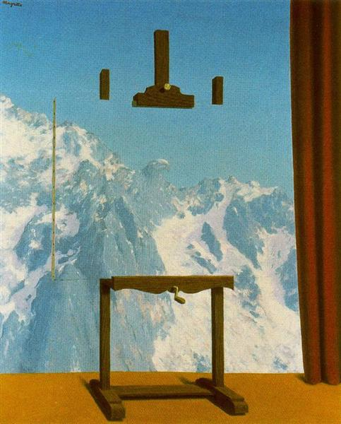
RHIC Run 22 Startup Status 11/23/2021
Blue cooldown underway, Yellow started
Still on track for Blue injection late evening Dec 1.
Yellow injection unlikely before late evening Dec 3.
Ops detailed schedule:
https://www.cadops.bnl.gov/AGS/Operations/OpsWiki/index.php/RHIC_Start-up_2022

Slide 2
Aggressive timeline for RHIC startup 11/30/2021
 | Wed 12/1 | 12/2 | Fri 12/3 | 12/4 | 12/5 | Mon 12/6 | 12/7 | 12/8 | 12/9
Owl | p.s work | Blu inj/pC | Blue inj, hysteresis, pC | Yellow inj, pC, first ramps? | Ramps/pC | Store setup
Day | p.s. work | p.s work | p.s. work |  | Rebucket | Ramp up and transition to physics
Eve | Blue inj | p.s work | p.s work |  | Rebucket
CeC beam-based alignment to take place in parallel with pC setup/conditioning where possible
Dec 6th and after days reserved for optimization and contingency:
pC target finding conditioning: 12 hrs
CeC BBA: 24 hours
Very like that some pC conditioning and CeC work remains by 12/6+
Shifts
Owl | 0001-0800
Day | 0800-1600
Eve | 1600-2359

