Slide 1
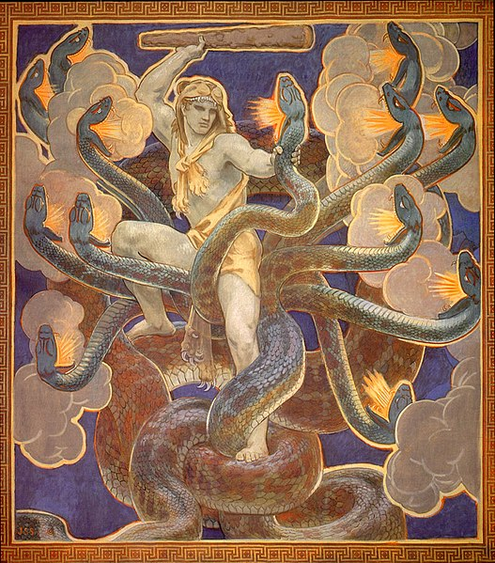
RHIC Run 22 Startup Status 12/14/2021
RHIC beam startup
Since the 12/3 power outage
Damaged coils #2 of 4
Used #1 and #4 as a partial snake
Parameter scans to improve polarization: partial snake current, tune scan
28x28 bunch ramps, 1.2e11 (need 2e11 for physics)
Blue polarization at 255 GeV: ~52%
Yellow polarization at 255 GeV: ~56%
(Very few measurements, low intensity, not enough beam at store for Jet)
Downtime from overheated quench switch (two lost stores, main QLIs)
Power dip 12/12 2100
Damaged coil #4 of bi9 snake (measures as ‘open’)
Misconfigured UPS at the abort kicker led to loss of beam sync signal, kick mistimed to the abort gap.

Slide 2
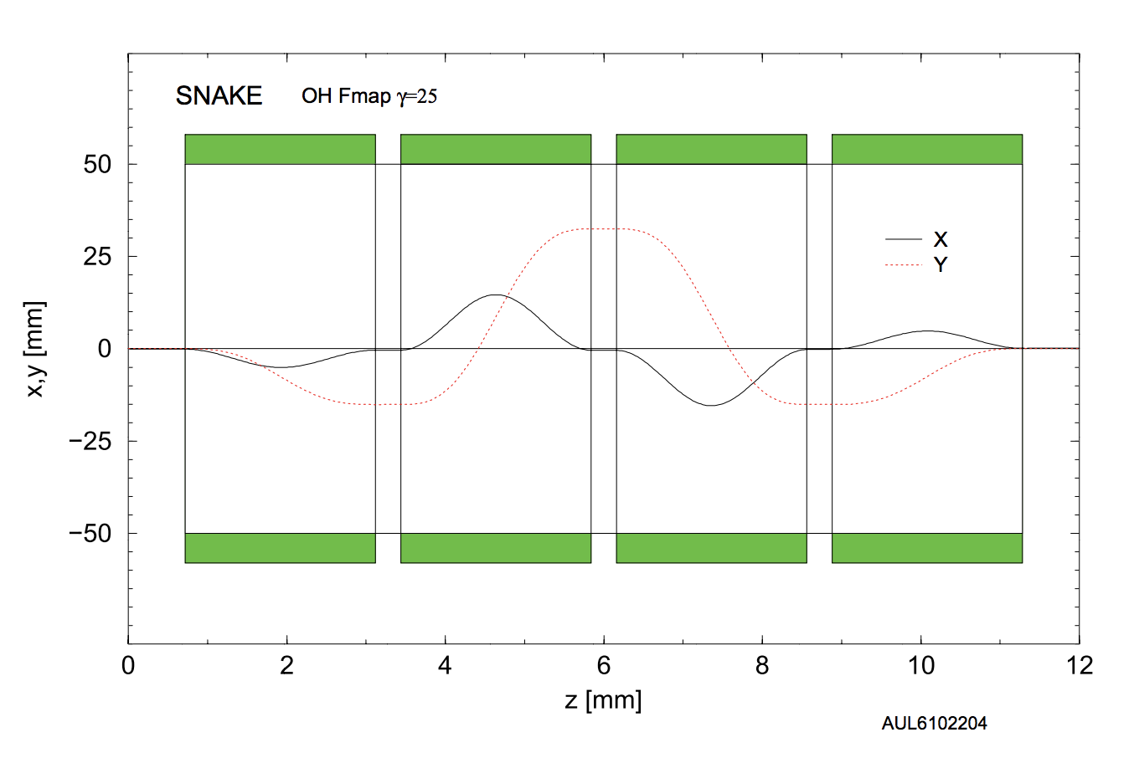
Bi9 snake coil failures
Not clear why two coils in the same package (but wired separately) would fail now during power outage/dips
Outer coil did not fail during the one solely beam-induced quench that happened after the 12/3 outage (not clear how much beam loss contributed to magnet trip during 12/12 power dip)
Developing testing and beam commissioning strategies to
test the remaining coil integrity early (is there a systematic problem here?)
Minimize risk of beam loss on the remaining magnets
New coil configuration (with #1 and #3) should function similar to previous (#1 and #4) configuration

Slide 3
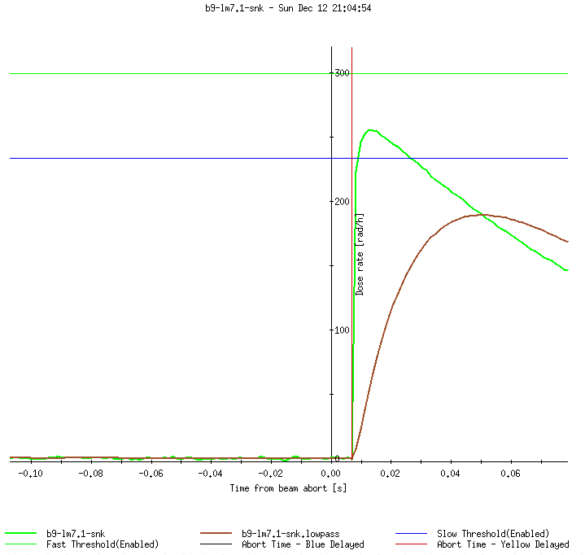
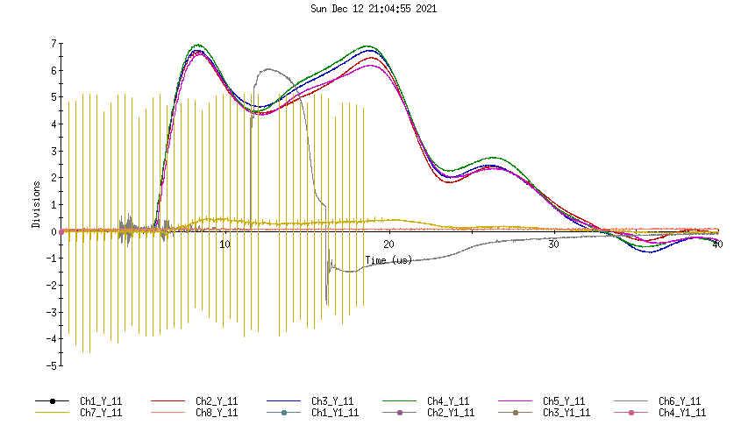
Abort kicker UPS failure
Abort kickers responded to loss of beam permit during the power dip in ‘delayed’ mode (correct mode)
No loss during the 7 ms delay (MPS functions correctly to disallow unacceptable loss during the delay)
The beam sync signal to the abort kicker had also lost power and was not properly on UPS (incorrect)
Without beam sync, kicker cannot fire timed to abort gap, but will fire.
UPS is now properly configured to supply power to beam sync link in case of another dip

Slide 4
Tasks for the next few days:
Today
Day: Access for CeC alignment
Day->Eve: Ramp development: - transfer of split/merge, intensity increase
Eve->Owl: Modest colliding stores for forward upgrade commissioning
Tomorrow (Wed, Maintenance)
Day; Snake reconfiguration, if available
Day->Eve: Ramp development if time allows, return to stores for overnight
Eve->Owl: stores
Thursday
Day: Snake reconfiguration or ramp development
Day-Eve: Reintroduce snakes if demonstrated stable operation at high intensity
Eve->Owl: stores with most stable demonstrated configuration.
Commissioning plan:
Demonstrate intensity needed for physics+~25% during development without blue snakes.
Introduce snake back into the lattice and walk intensity back up to ‘known’ stable settings

