Slide 1
RHIC Run 22 Startup Status 12/21/2021
Operating with two damaged coils in bi9 snake
Second coil damaged on 12/12 (just prior to last time meeting)
12/12-12/19
Power supply/magnet group investigation of coil failure
Rewiring of power supply to remaining two coils still allows operation as a partial snake
Addition of UPS to both snake supply and associated controls
Huge effort done safely and quickly.
High current shutoffs did not find any problems with remaining coils
Beam operation during this time: get to physics intensity levels without the blue snakes, ensure stable beam (higher than normal tune spreads).
12/19: Recommission with partial snake
~4 hours to return to previously established store conditions, now with snake
12/20, just beginning regular stores

Slide 2
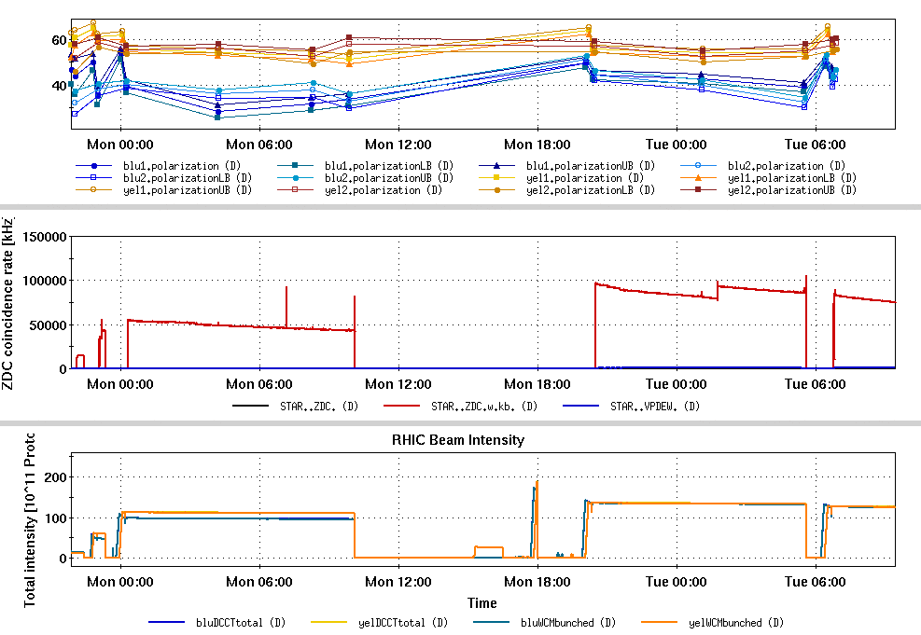
Collider performance with partial snake
Run 17 full store avg polarization: 55%
Yellow very close to Run 17: ~55%
Blue: ~42% (pC full store average)
Partial snake causes
Polarization Loss on injection into RHIC
Lower polarization ramp transmission
Store spin tilt and decay
Some improvement in ramp transmission ramping the partial snake to 320 A during acceleration.
Higher current is overly lossy at injection energy
Bi9 snake: 300 A
Bi9 snake: 300->320 A
Polarization
ZDC
Int. [1e11]

Slide 3
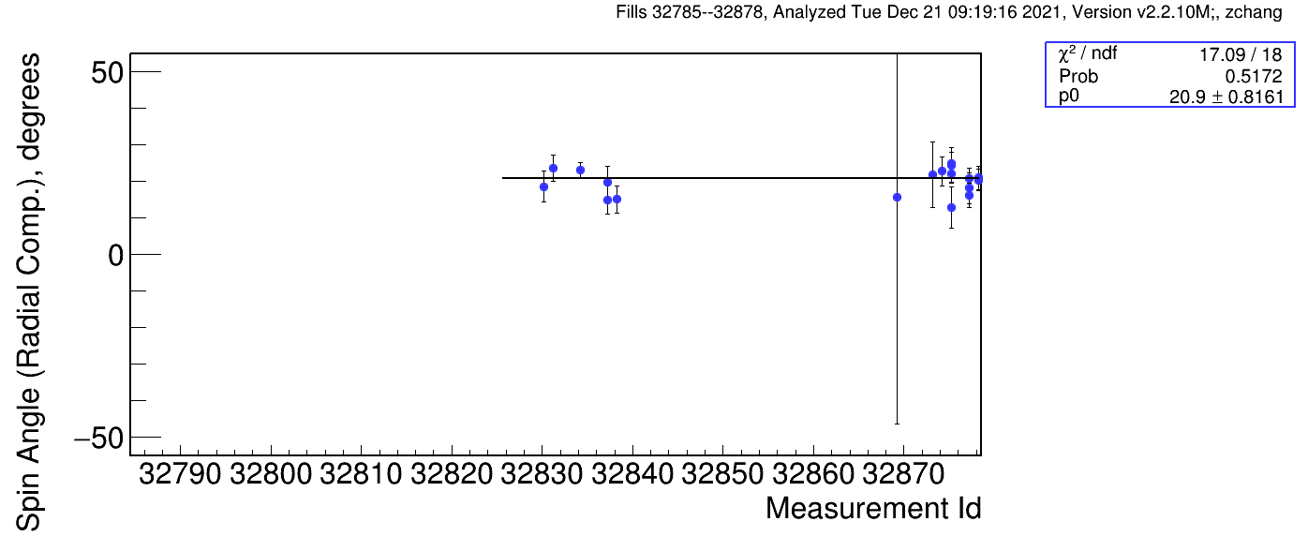
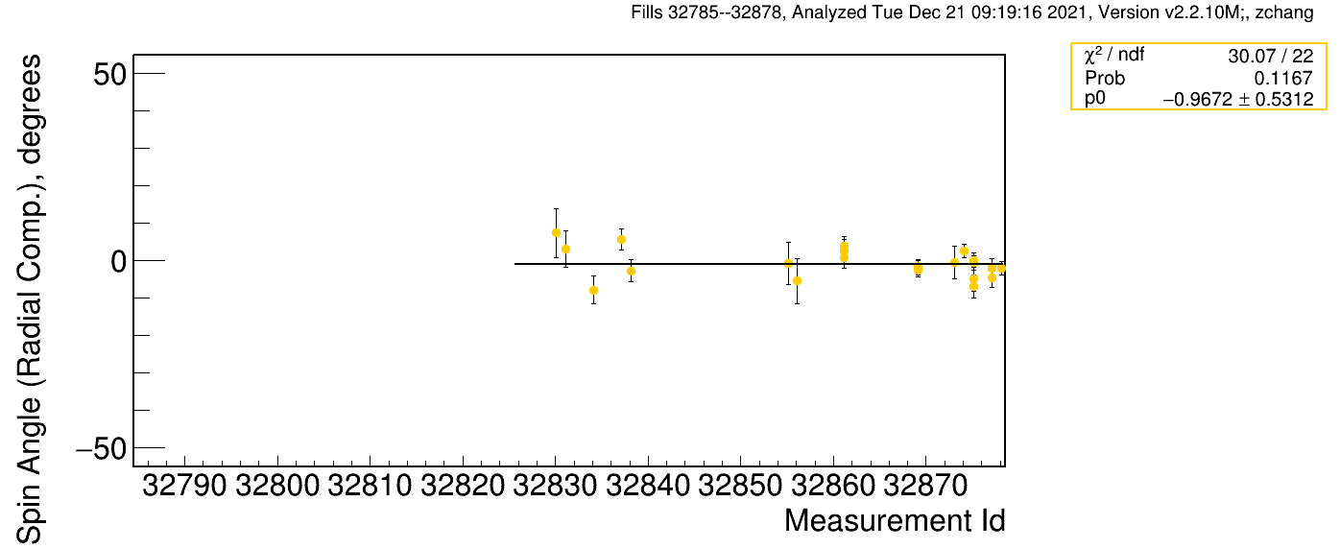
Plans for polarization improvements
Injection loss: modify rotation in 3 o’clock snake to compensate
Higher current in the 9 o’clock snake also works, but increases losses on snake
Ramp transmission
Orbit manipulations to counter snake imperfection
mechanics still to be worked out
In the plan for both rings for Run 22 prior to the helix damage
Store spin tilt/decay
Measured ~20 deg tilt at pC polarimeter
Possible global orbit manipulation to correct
Uses imperfection resonance to rotate spin back
Possibly use rotators to measure and correct longitudinal component at IP6

Slide 4
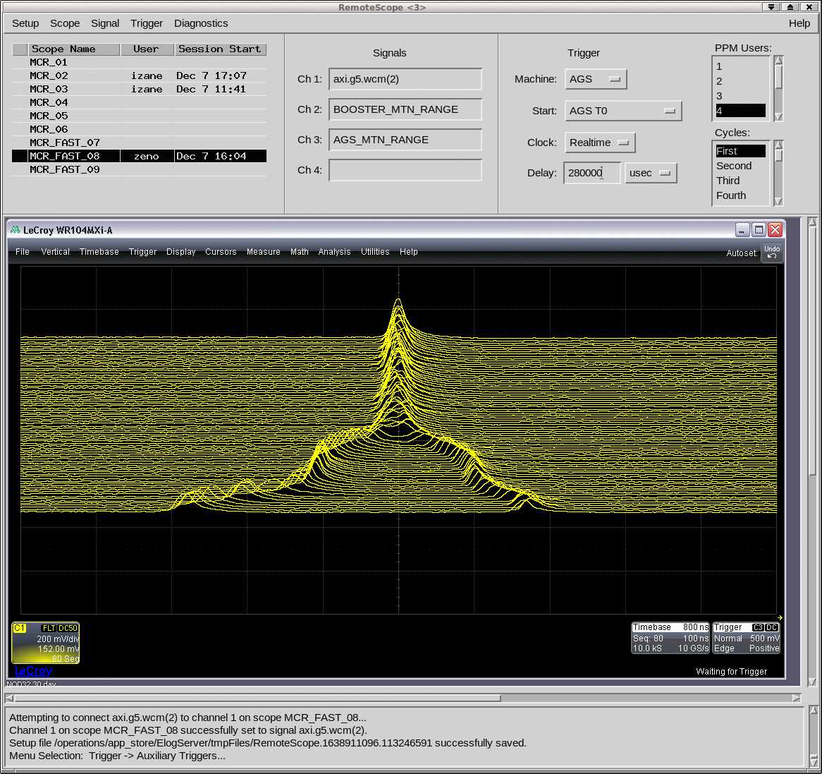
Other outstanding setup items
Luminosity still only up to 30% of required
Discrepancy between expectation from Run 17 and what we measure (factor of 2 lower now, accounting for lower intensity)
Large emittance?
Vernier scan today or tomorrow.
Split/merge injector scheme
Still needs some improvement in extracted bunch length to enable stable transfer to RHIC.

