Slide 1
Polarization Status at pC and STAR
E.C. Aschenauer

Slide 2
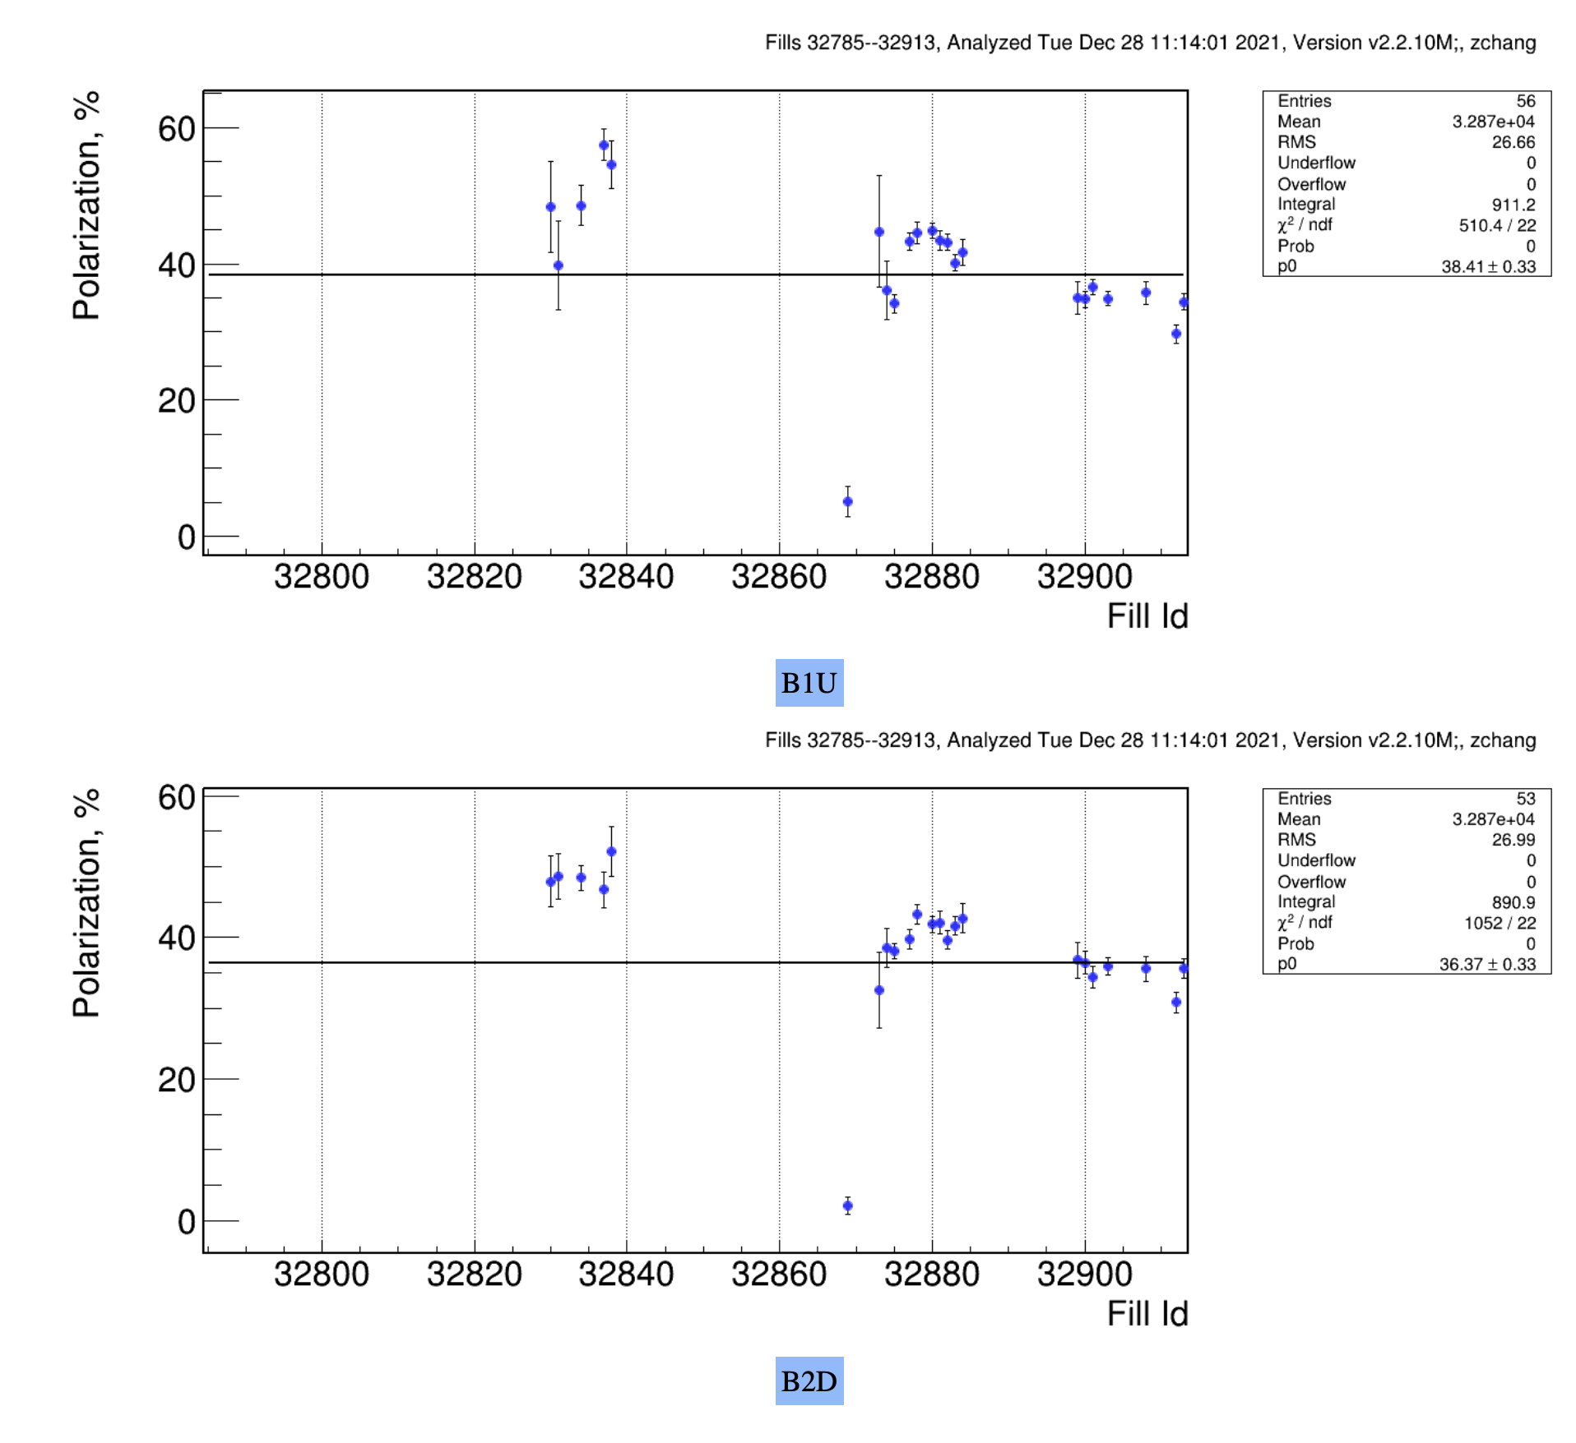
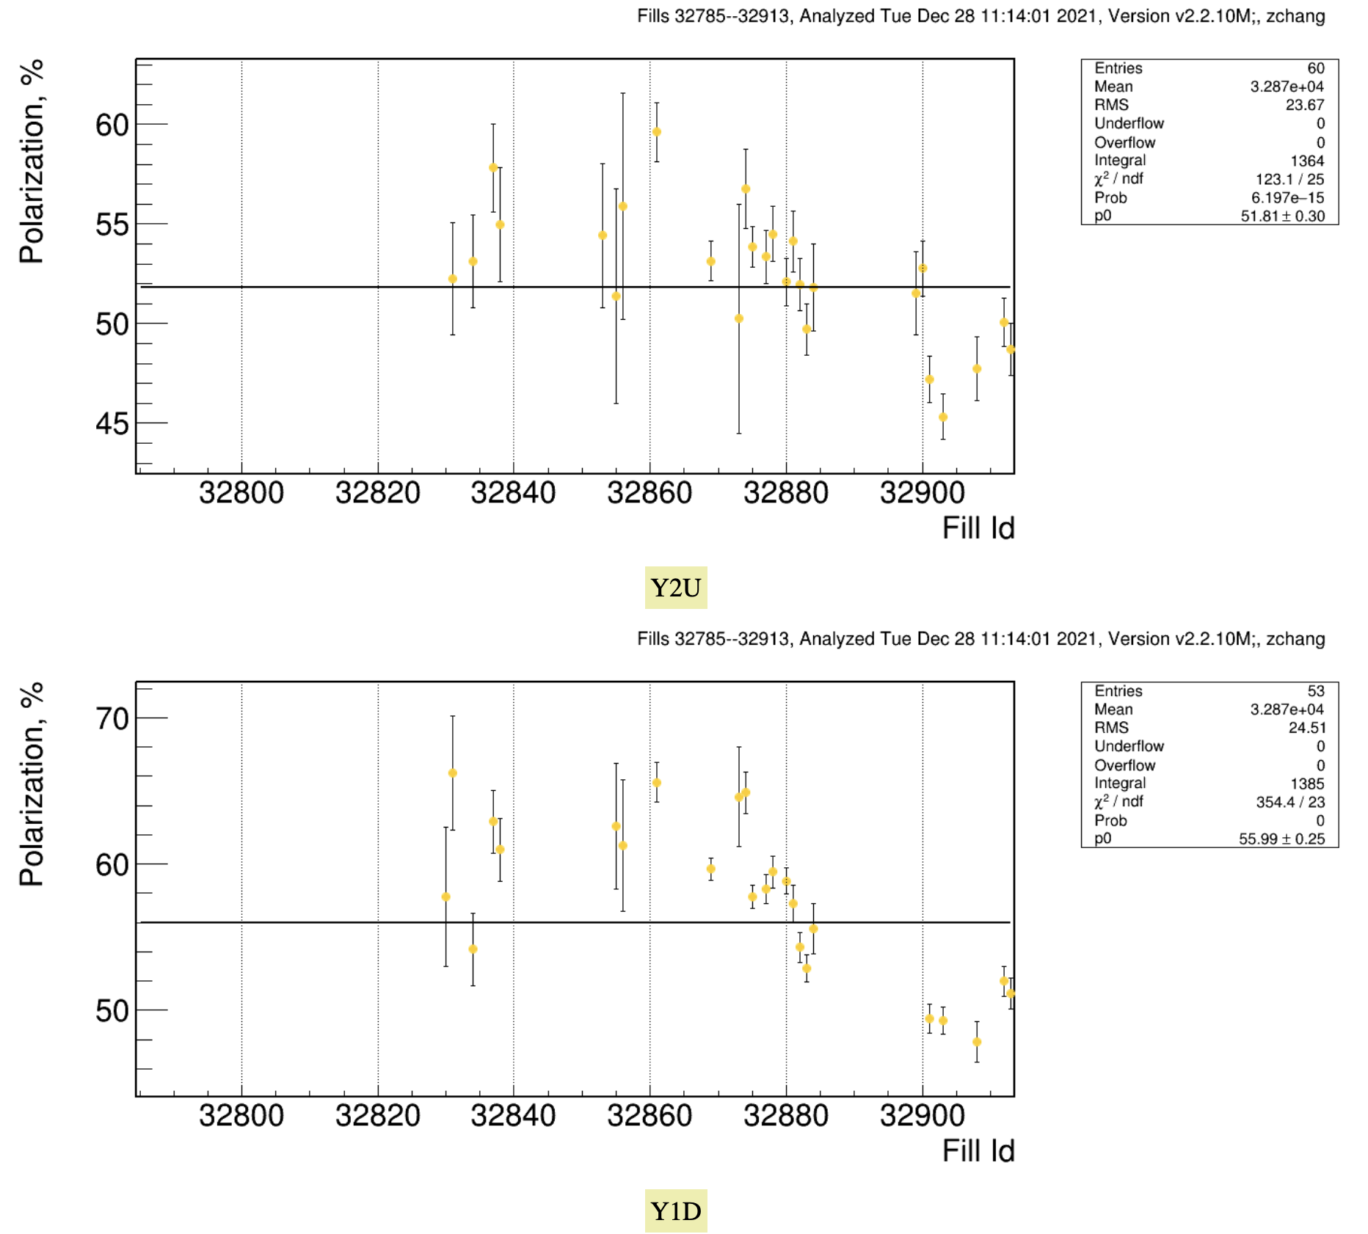
Measurements by pC
Yellow polarization is also on the low site in the last fills
2017 – values: Blue: 54.7 Yellow: 55.8

Slide 3
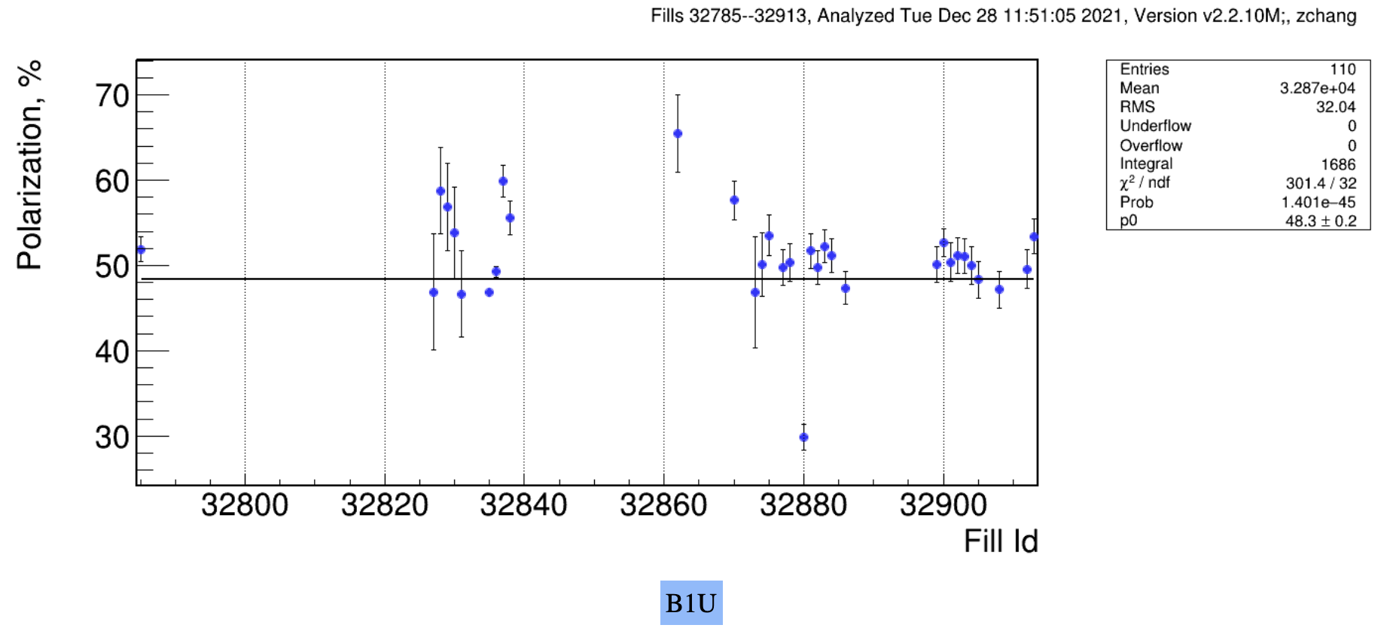
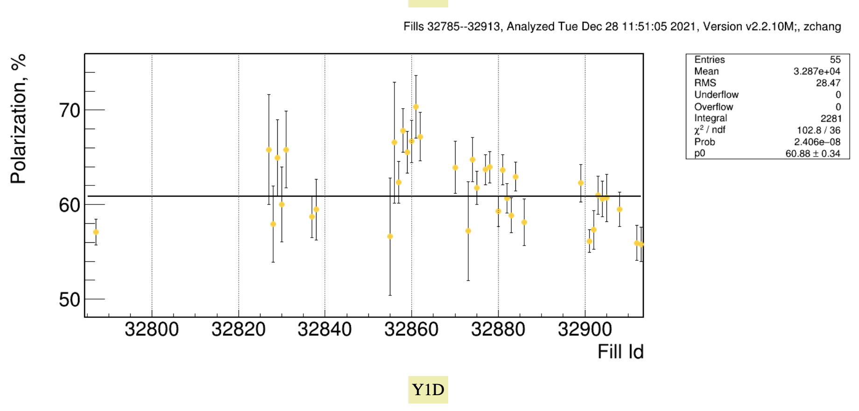
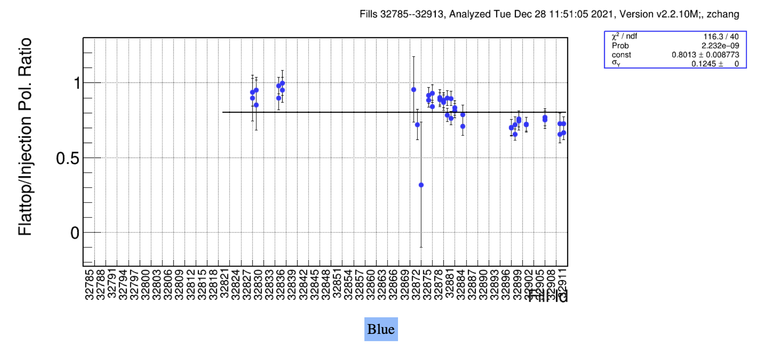
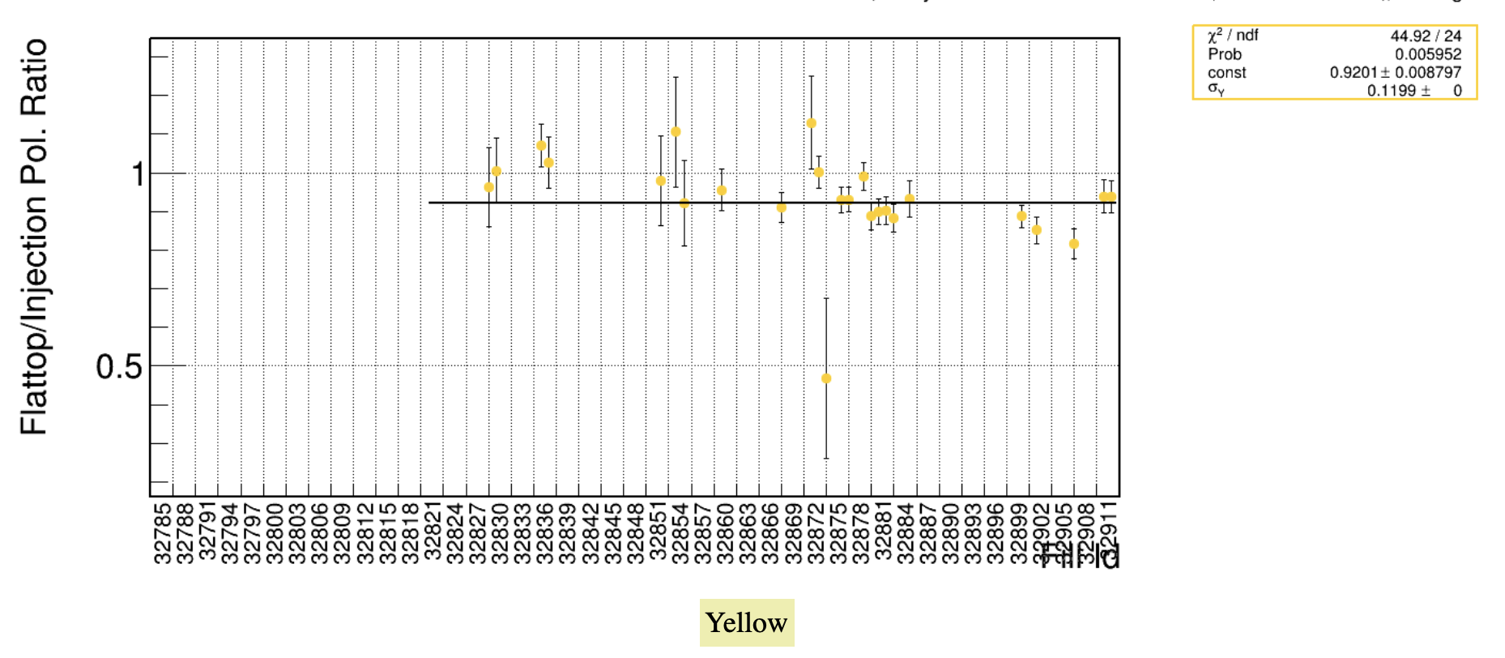
Polarization at Injection & Ramp Efficiency
Polarization@24 GeV

Slide 4
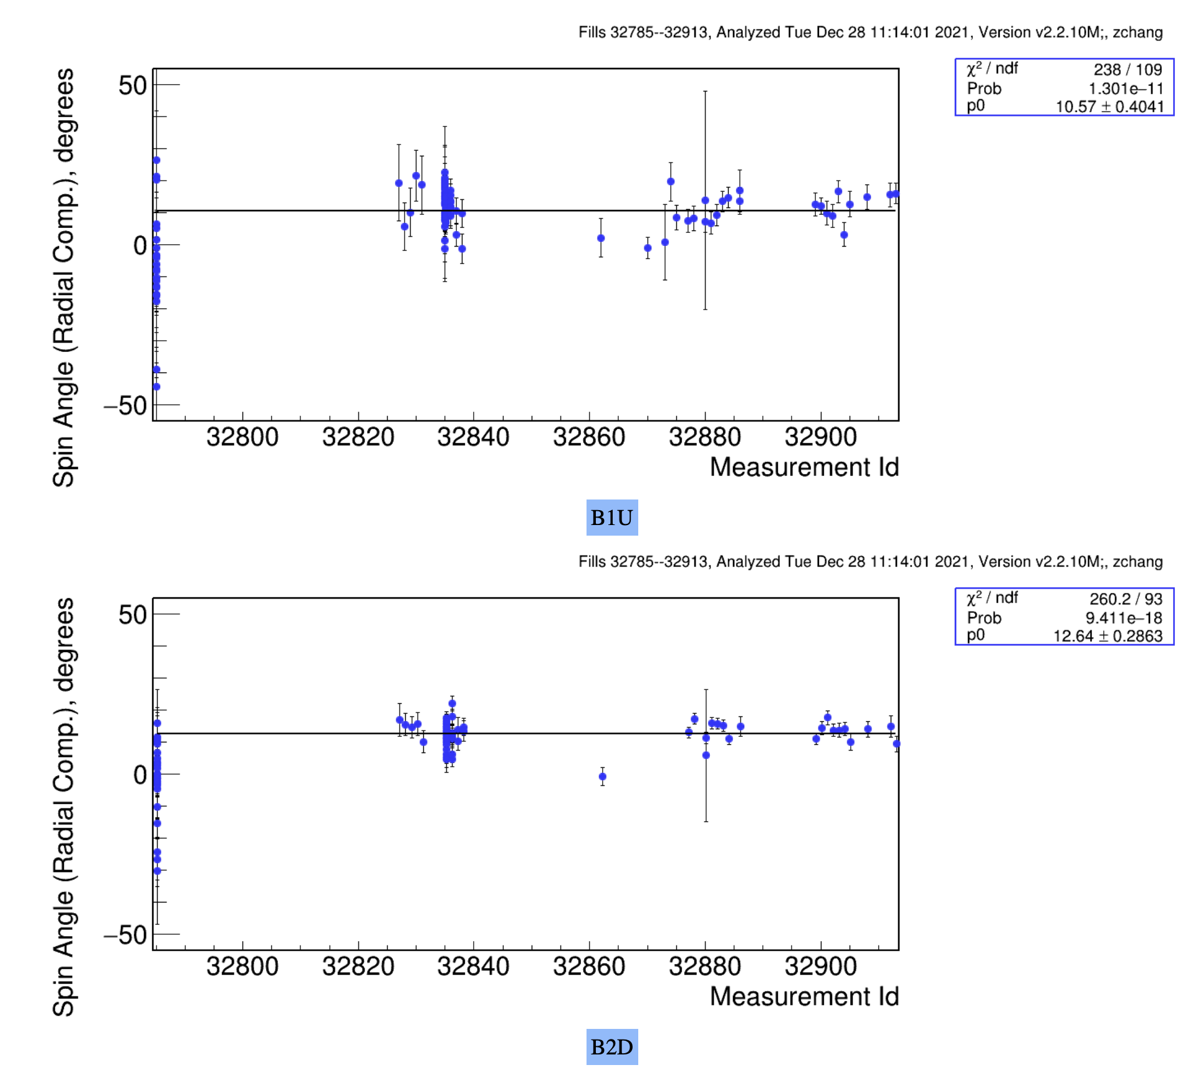
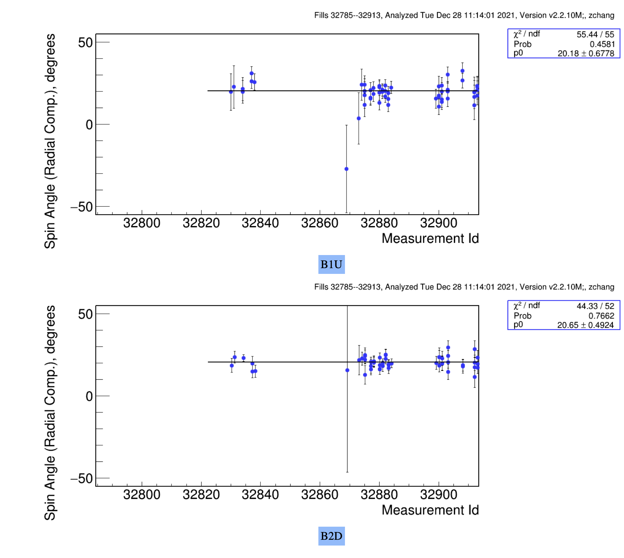
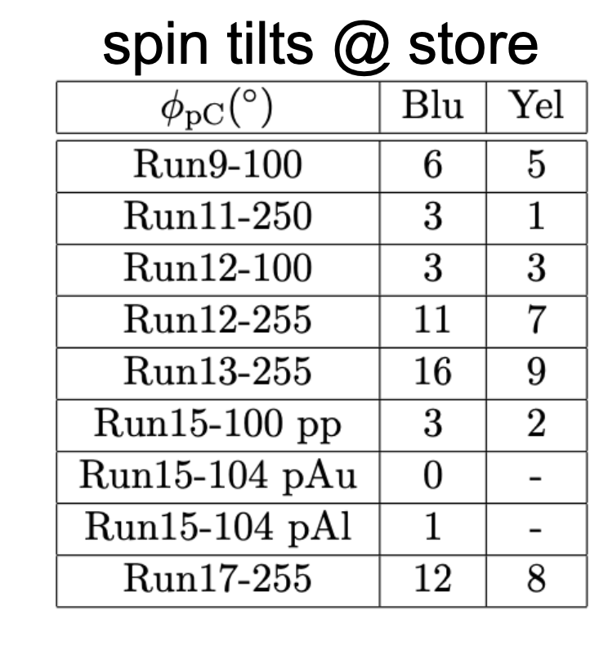
Polarization direction at pC
24 GeV
255 GeV
2022: no spin tilt in yellow at injection
and at flat top
Blue:
+φ_{pC}: spin tilted
towards ring - inside

Slide 5
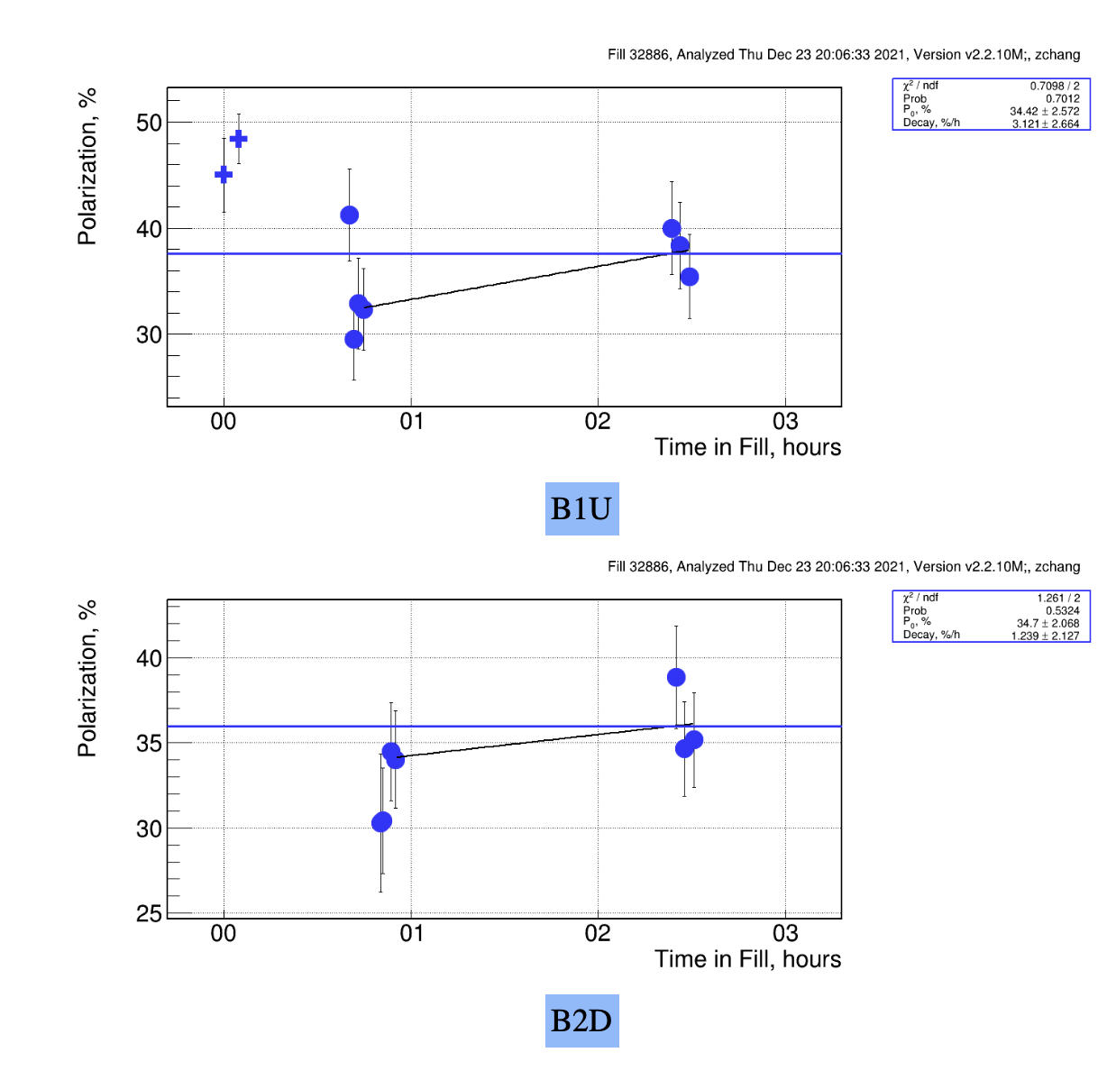
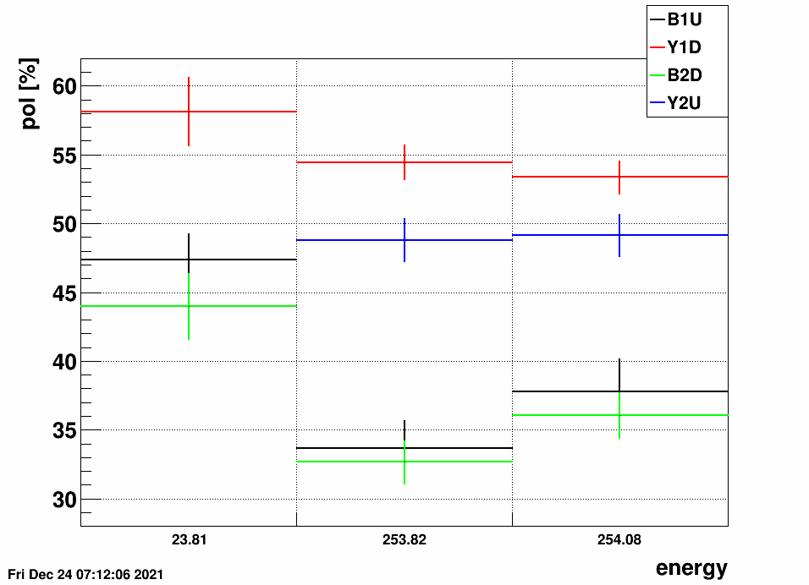
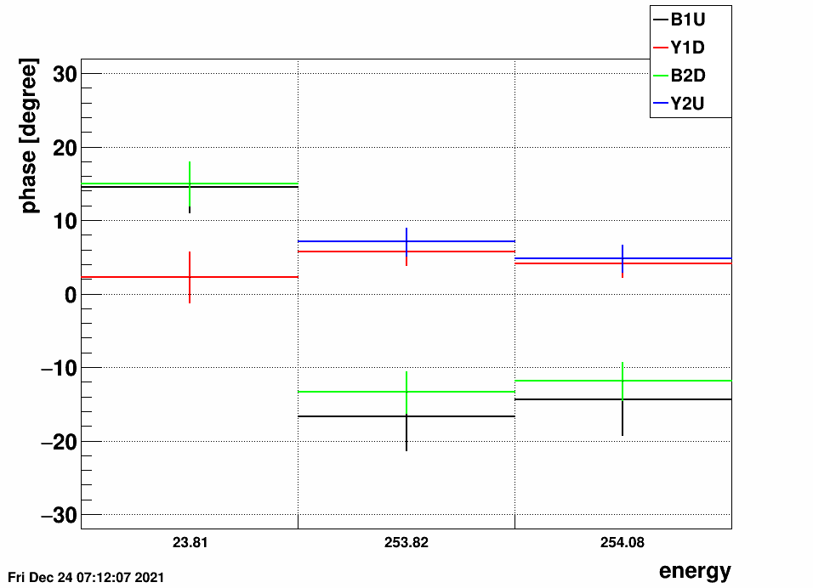
Beam Energy Scan
Fill 32886
Change in Blue polarization moving
longitudinal spin into transverse direction
Yellow remained in statistics the same

Slide 6
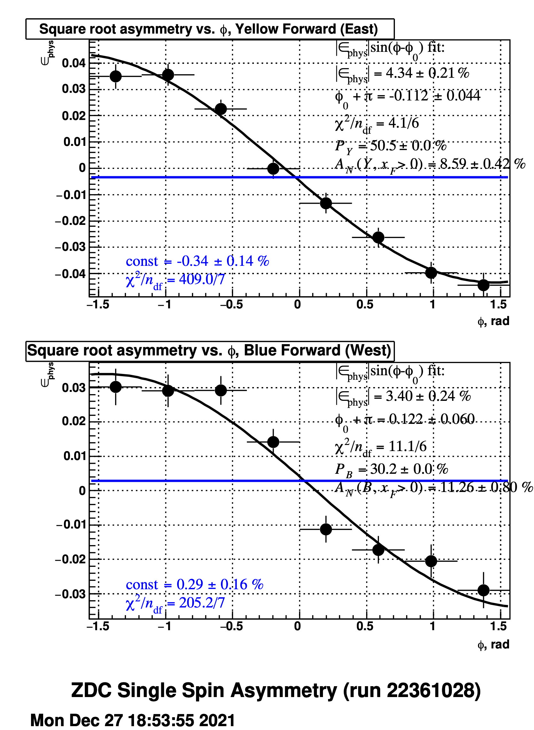
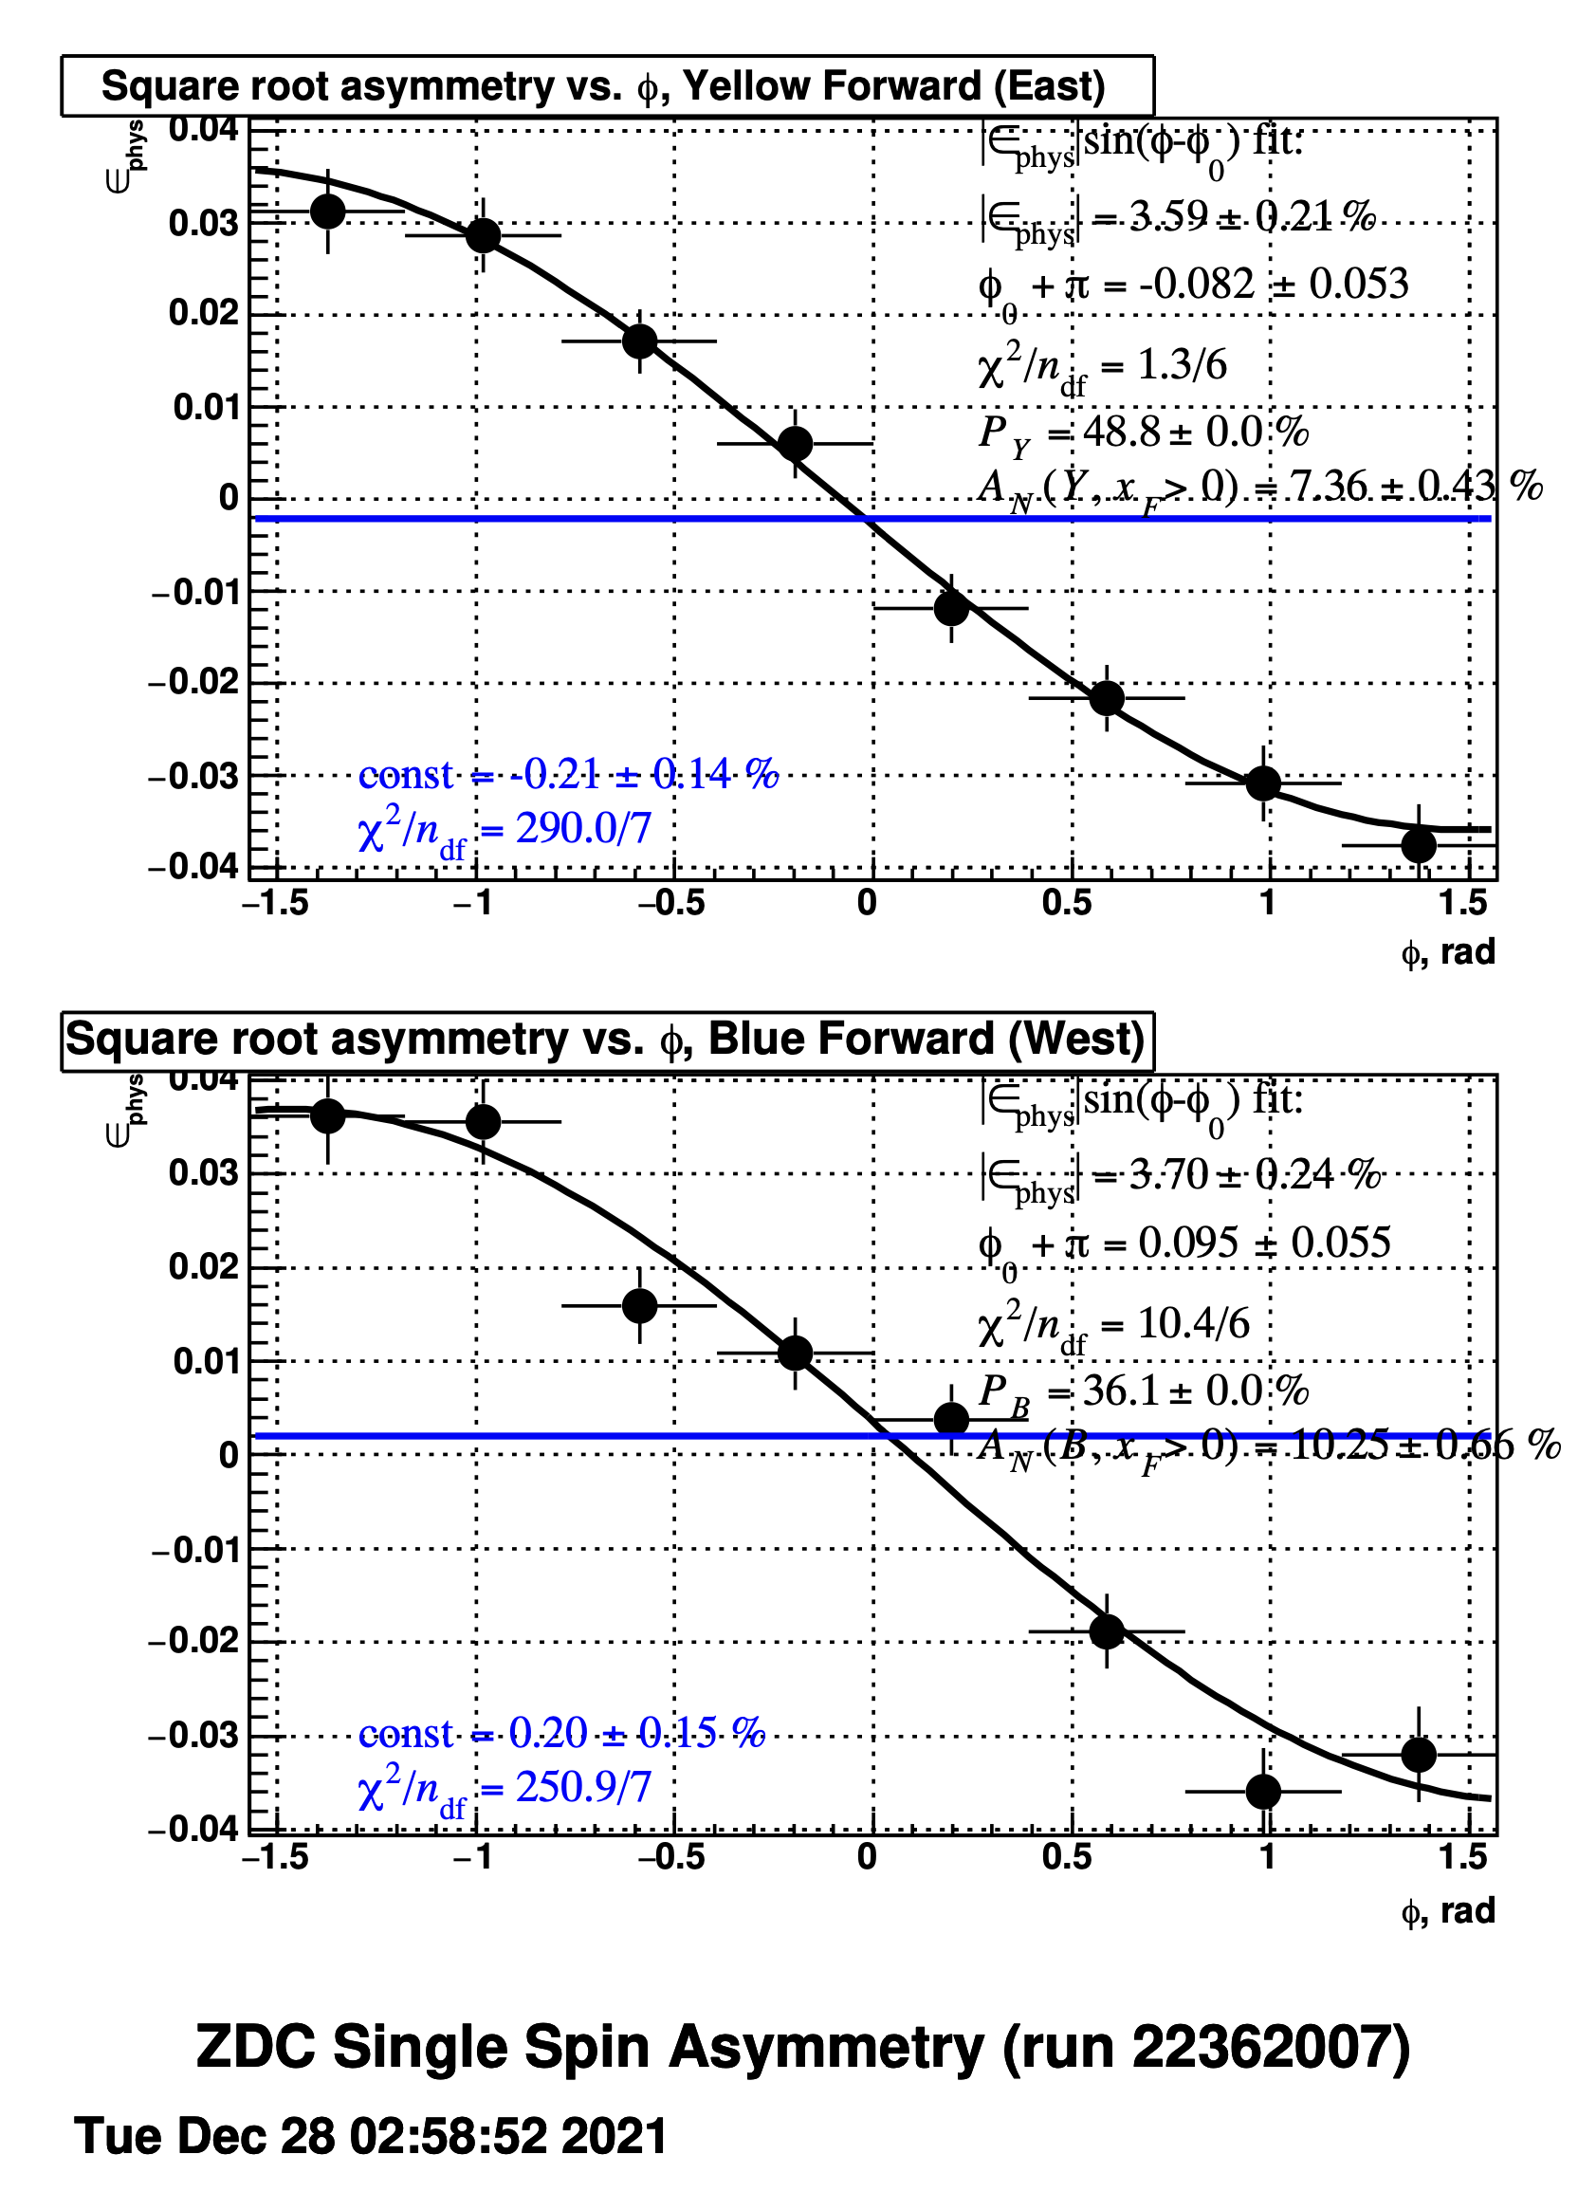
STAR Local Polarimetry
Fill 32912
Fill 32913
Small radial component both in Yellow and Blue
→ pC significant radial component
Blue: transverse component at IP6 and pC are different
A_{N} Yellow $≠$ A_{N} Blue
longitudinal component at IP-6 and pC need to be determined through machine studies

Slide 7
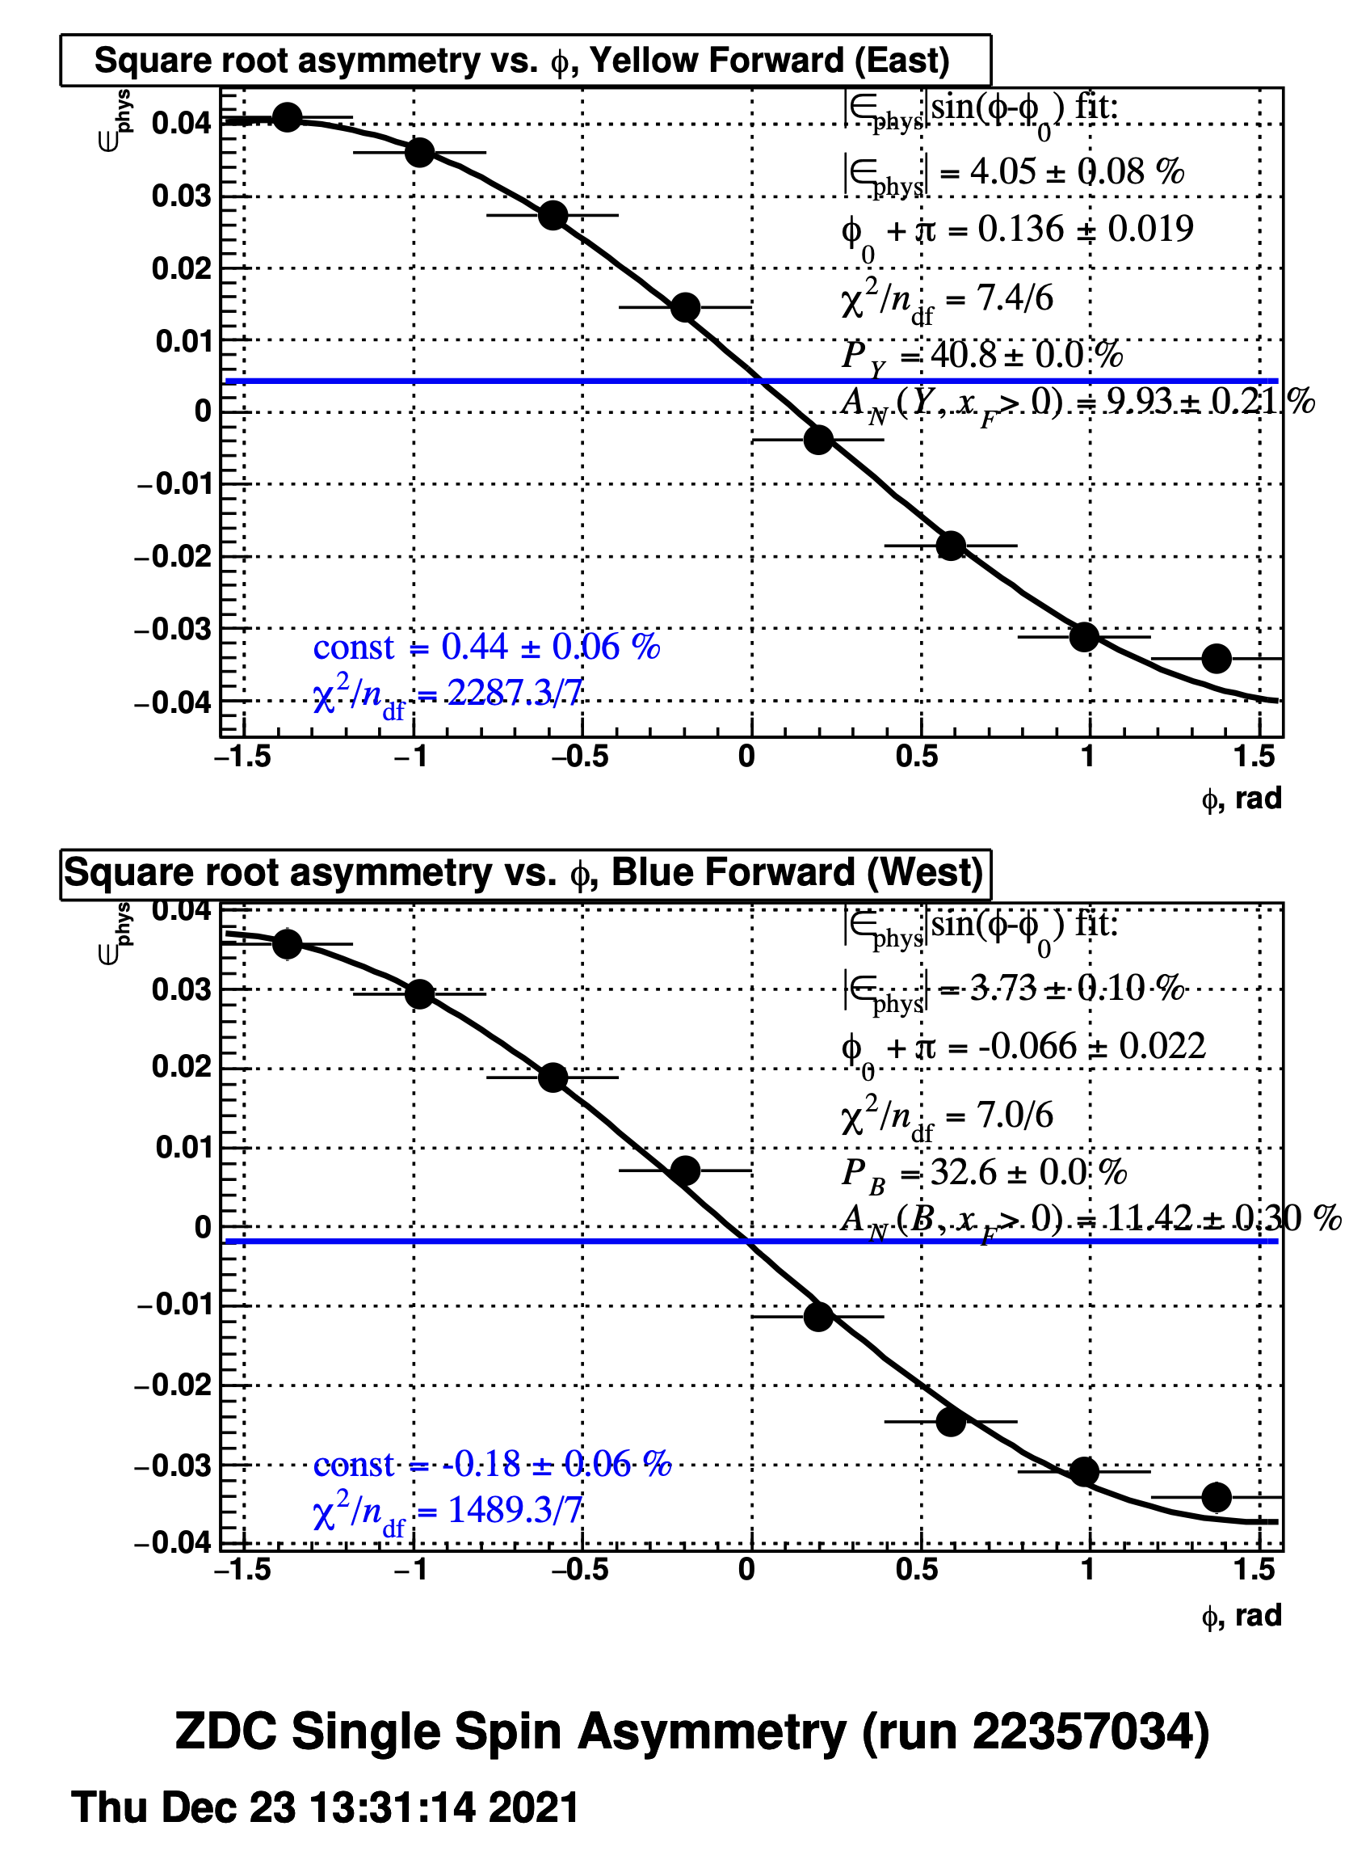
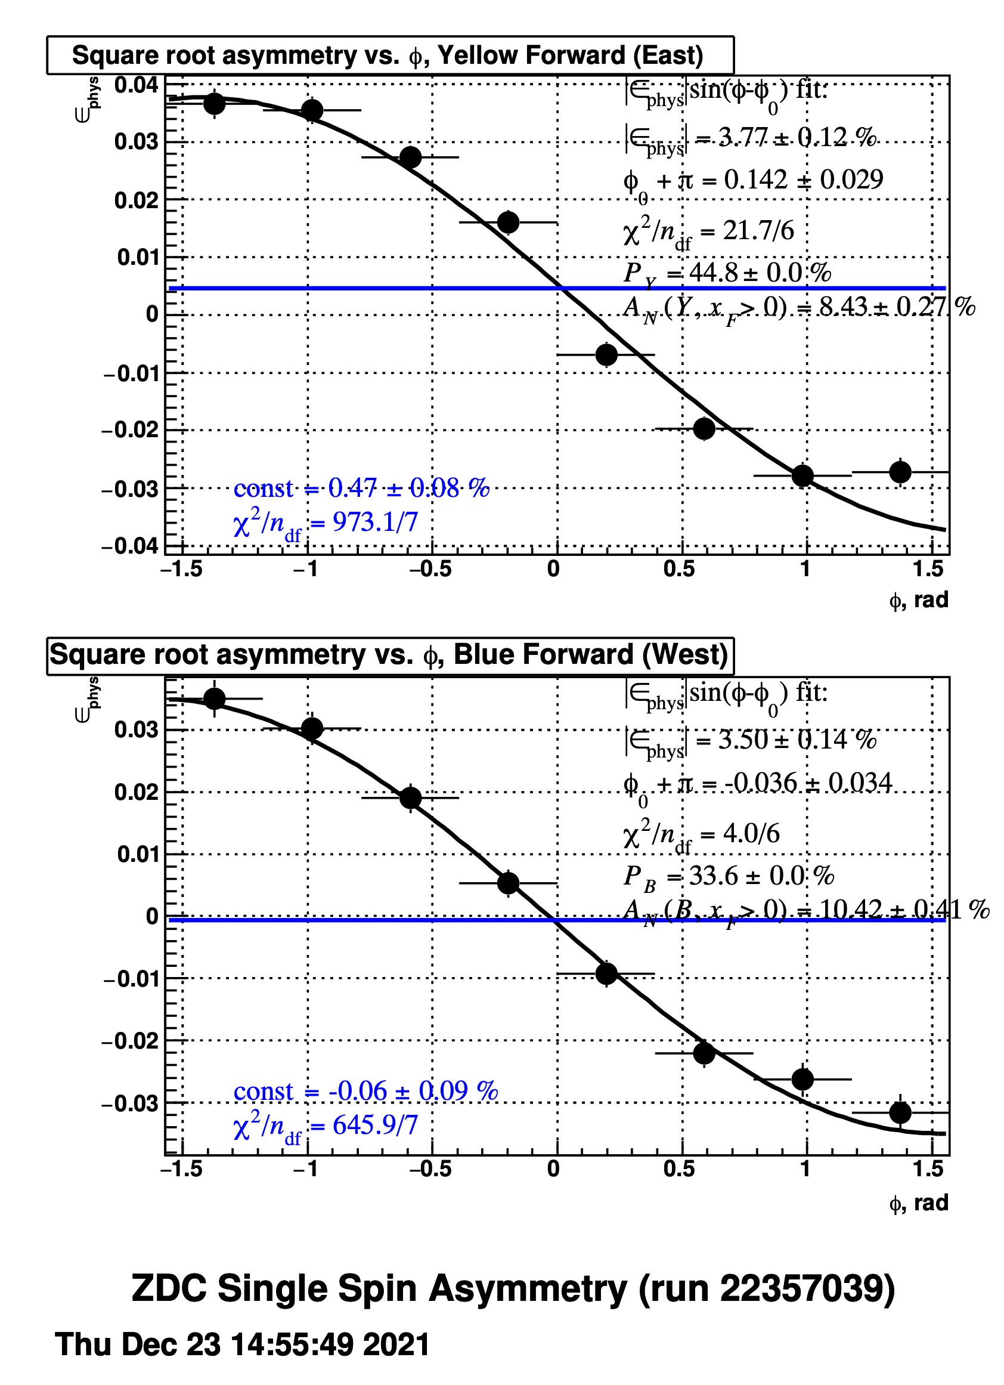
STAR Local Polarimetry Energy Scan
radial component
in Yellow
very small radial component
in Blue
transverse component at pC < STAR
no radial component
in Blue
transverse component at pC & STAR
agree a bit better

Slide 8
Summary
Transverse component at STAR and pC are different
transverse component at STAR seems bigger as at pC
What do the spin tracking results show/predict?
do we have the same spin direction at H-jet and pC?
No clear idea about longitudinal component
→ really need to do a systematic check
continue energy scan
turn on rotator around STAR

Slide 10
RHIC and Polarimetry
Absolute Polarimeter (H jet)
RHIC pC Polarimeters
Siberian Snakes
RHIC
(s)PHENIX
STAR (p)
Siberian Snakes
180º flip
Spin Rotators
Solenoid Snake
LINAC
BOOSTER
Pol. Proton Source
500 μA, 400 μs
AGS
Warm Snake
200 MeV Polarimeter
AC Dipole
AGS pC CNI Polarimeter
Cold Snake
Some Facts:
CDEV spin direction the one at the source, id even spin flips source to RHIC
IP-12 spin direction and source are the same → IP-6 spin direction == -IP-12

Slide 11
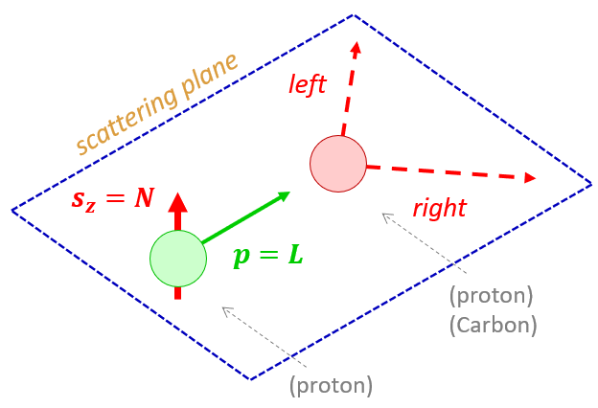
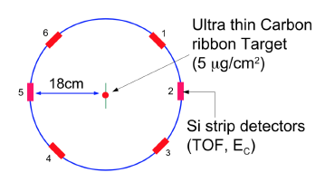
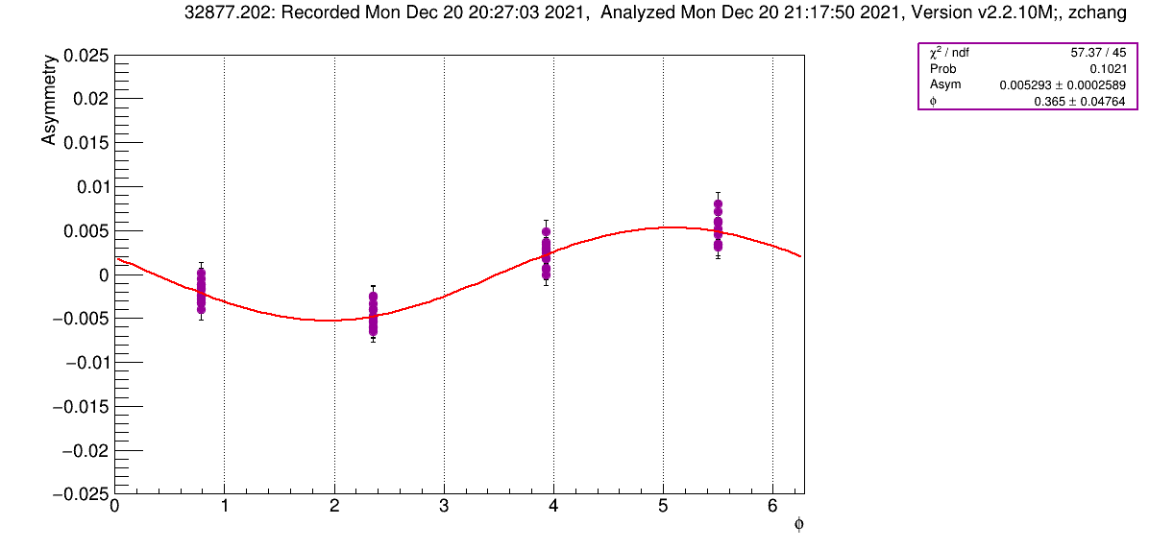
pC Polarimetry
y
Coordinate System: → Blue Beam
z
Ring-outside
x
Note:
= 0 = +y
For yellow beam x-axis is flipped
+x points ring-inside
Blue:
+φ_{pC}: spin tilted
towards ring - inside
Φ is the angle away from vertical
B2D
Run22 24 GeV 8-10 0
Run22 255 GeV 20 0
Polarimeter–Info: https://www.cnipol.bnl.gov/rundb/

Slide 12
STAR Local Polarimetry
Local polarimeter normally used
to ensure beam is longitudinal if spin rotators are used
→ A_{N} disappears if spin is longitudinal

Slide 13
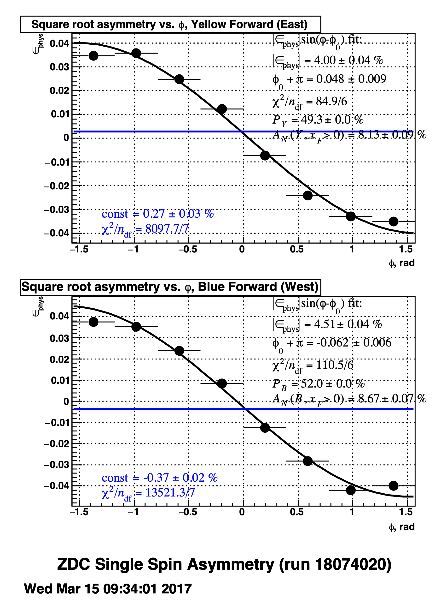
STAR Local Polarimetry
Run-17
Note:
1/P x ε_{phys} = A_{N}
A_{N} Yellow = A_{N} Blue
$$\frac{e_{Phys}^{Blue}}{e_{Phys}^{Yellow}}=\frac{P_{B}}{P_{Y}}$$
All worked out in Run-17

Slide 14
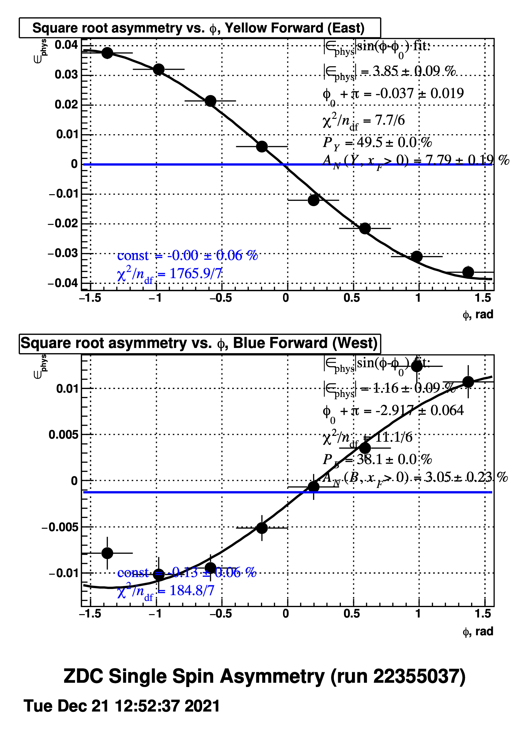
STAR Local Polarimetry
Note:
1/P x ε_{phys} = A_{N}
A_{N} Yellow = A_{N} Blue
$$\frac{e_{Phys}^{Blue}}{e_{Phys}^{Yellow}}=\frac{P_{B}}{P_{Y}}$$
Run-22 – Result from last Tuesday
Yellow:
A_{N} & ε_{Phys}
Run-22 consistent with Run-17
BUT
can the difference in spin direction between IP-6 and IP-12 be soo big
Result also inconsistent with spin tracking simulations
→ let’s dig a bit deeper
Note:
ε_{phys} – blue 1/3 of ε_{phys} -- yellow
A_{N} Yellow and A_{N} Blue do not agree
still different by 2.55
this would need P_{Blue} to be
significantly higher
only explanation
significant longitudinal component at STAR

Slide 15
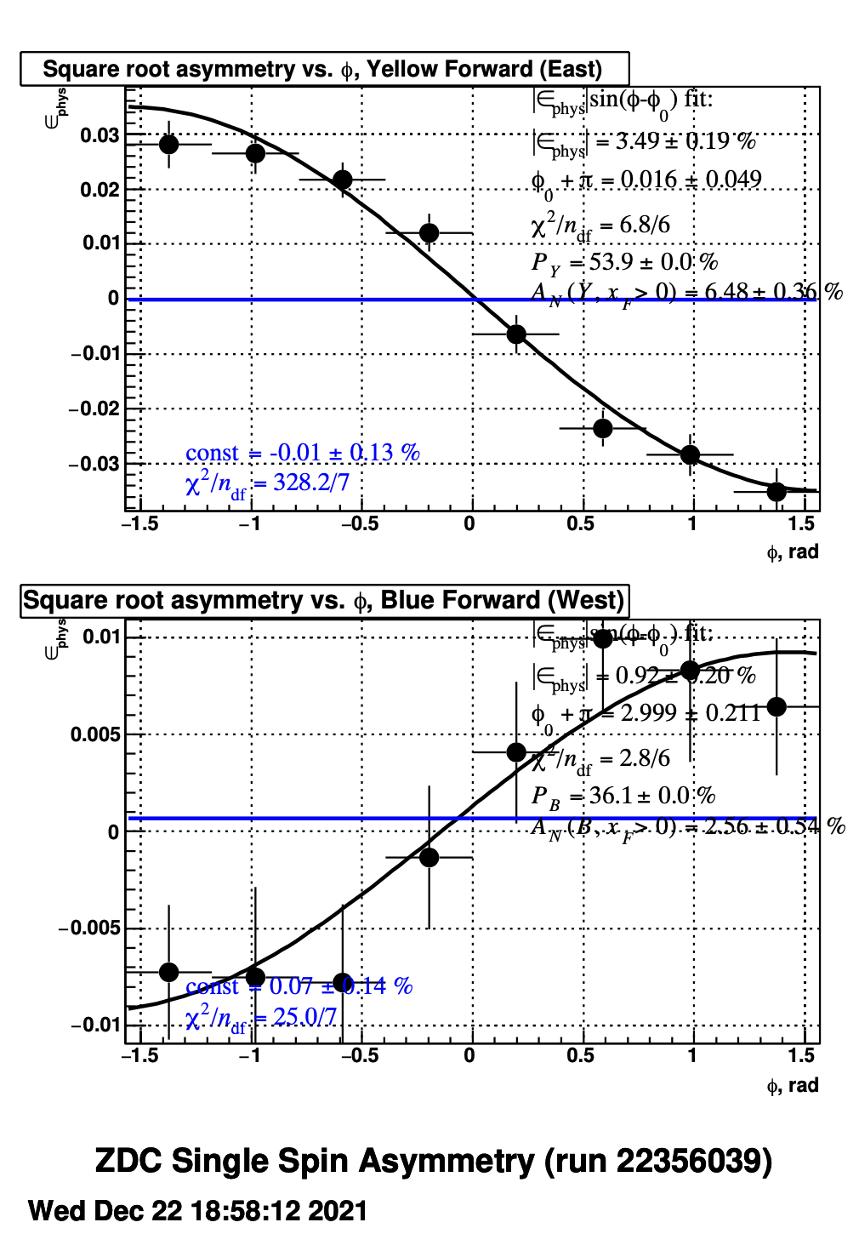
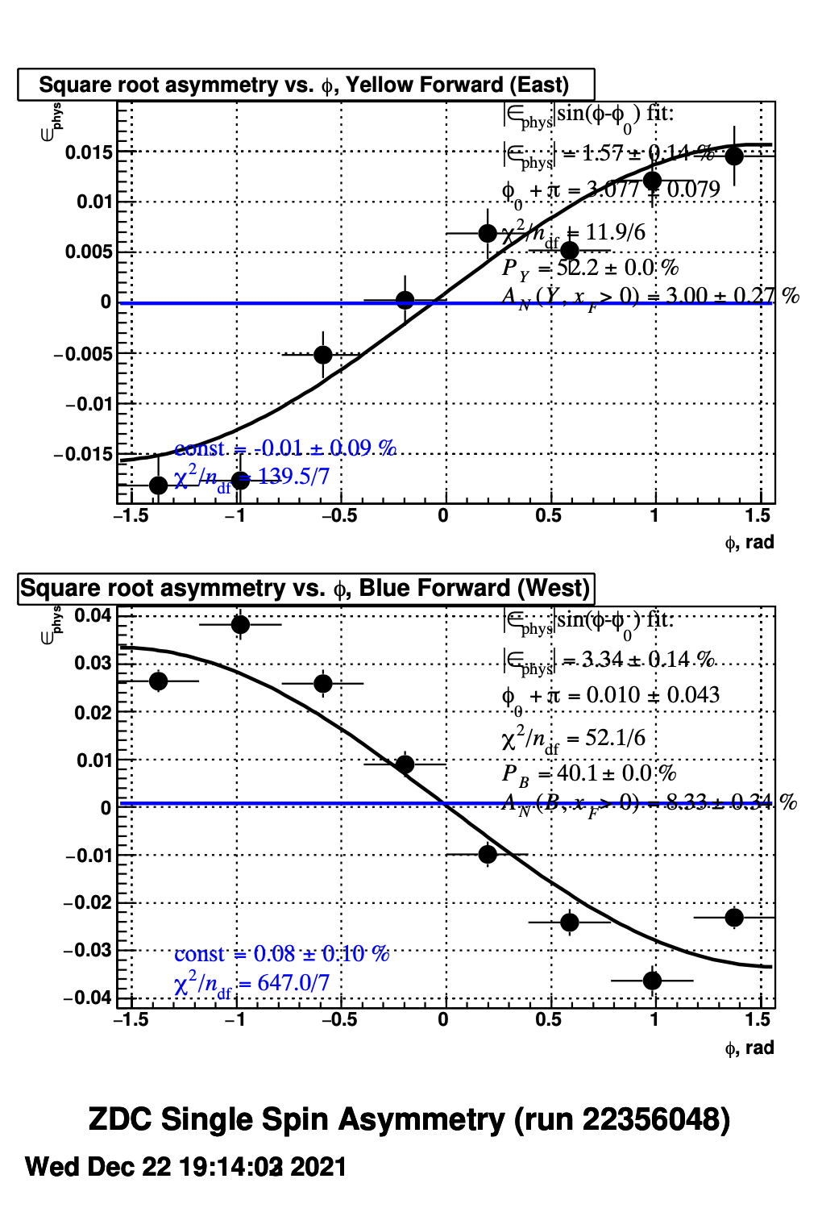
STAR Local Polarimetry
Fill 32881
Fill 32882
?
Only change between fills the spin pattern
Yellow
Blue

Slide 16
STAR Local Polarimetry
++--++--++|--++--++--|++--++--++|--++--++--|++--++--++|--++--++--|++--++--++|--++--++--|++--++--++|--++--++--|++--++--++|--++--++--|
Blue
10
20
30
40
50
60
70
80
90
100
110
120
--++++----|++++----++|++----++++|----++++--|--++++----|++++----++|++----++++|----++++--|--++++----|++++----++|++----++++|----++++--|
Yellow
90
100
110
120
10
20
30
40
50
60
70
80
green bunches: empty bunches → abort gaps
For local polarimetry it is critical to have bunch – id and spin direction
at STAR correctly correlated
→ Till 2017: reference was blue beam
Somewhen this was switched to yellow beam, maybe during BES fixed target running
Local Polarimeter code was not modified
Fun Facts:
does not matter a lot for spin patterns
→ Therefore, Yellow agreed between 2017 and 2022 and Blue was screwed up

