Slide 1
RHIC Run 22 Run Status 12/28/2021
Operation continue with partial blue snake at bi9
Dec 23rd: RHIC store energy scan
Goal to rotate the spin vector in blue to investigate the longitudinal component of stable spin direction at pC and STAR
Interrupted by quench detector problem (2 of 6 energies measured)
Quench detector problem
Full day without beam to diagnose
Two days of operation with a 5x slower energy ramp
Emittance problems
Large emittance dilution (vertical) during the ramp, unknown cause
Last night, injection matching problem in blue (resolved)

Slide 2
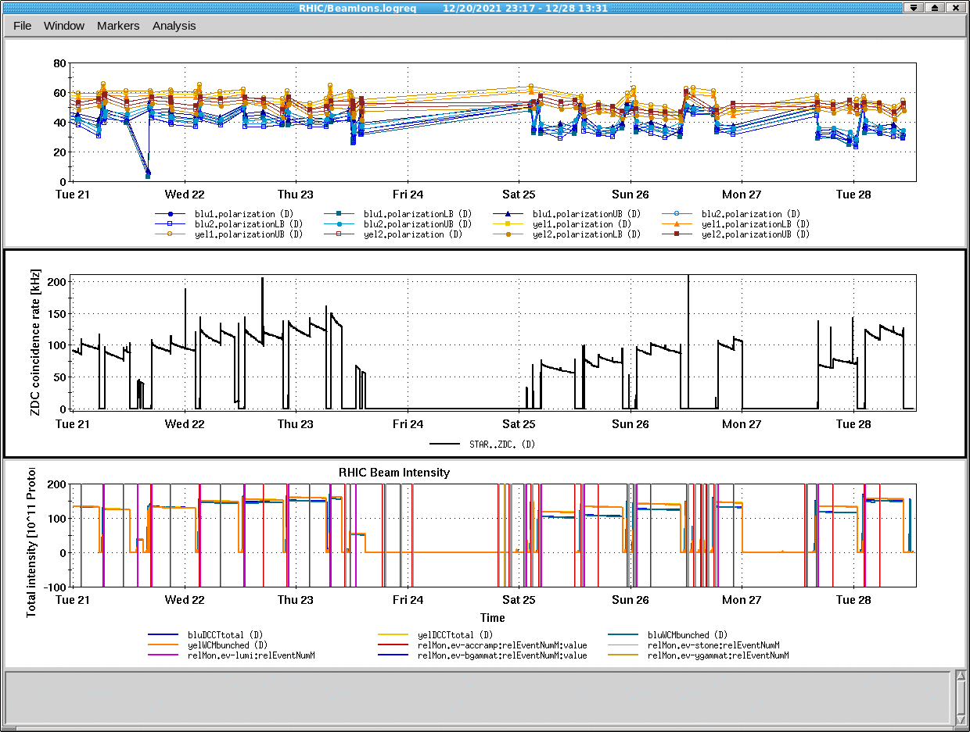
‘Normal’ operation
QD failure
Slow ramps
‘Normal’ operation
QD repair
Tune/chrom emittance
investigation

Slide 3
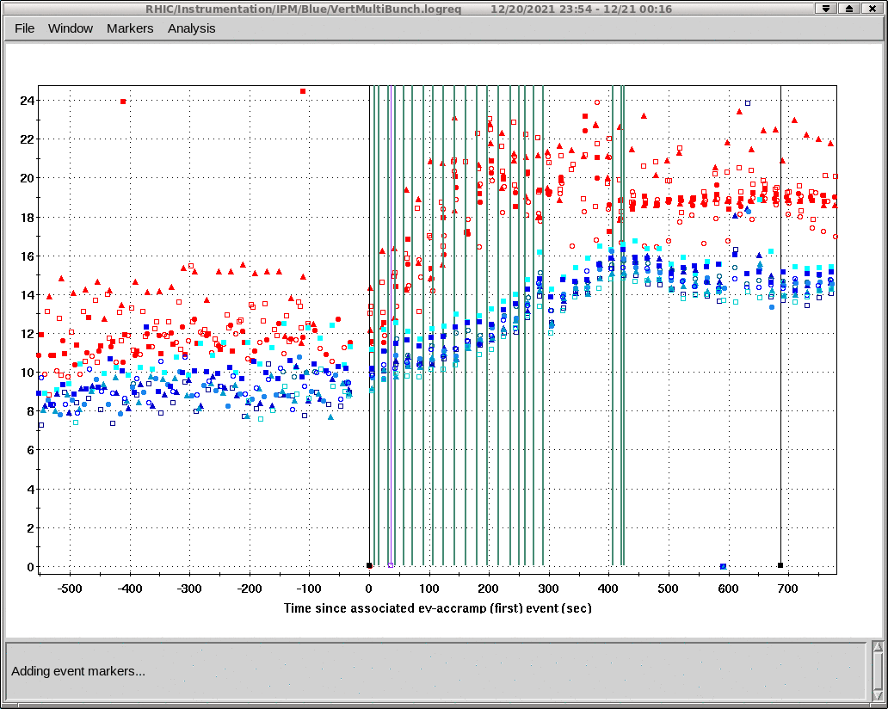
Blue vertical emittance growth during RHIC ramp
Run 22
Run 17

